Slide 1


Slide 2

INSTRUCTIONS
EACH CHILD WILL MAKE A POSTER USING 1 LETTER IN A4 SHEET PAPER/QUARTER CHART PAPER AS PER FOLLOWING TABLE: (SEND ME BEFORE 12 MIDNIGHT,07/05/2020)
CLICK A PICTURE OF THE CHILD, HOLDING THIS PAPER AND SEND ME ON MY WHATS APP NO.(AS SHOWN IN THE FOLLOWING PICTURE).
MENTION NAME AND SECTION ON THE CHART ITSELF.

Slide 3
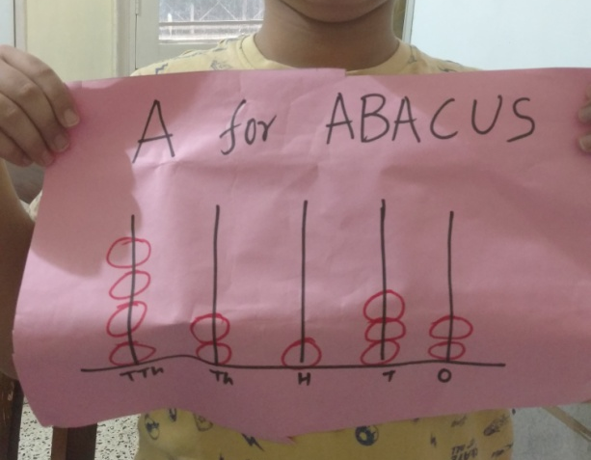
FOR EXAMPLE
CLASS 4 A ROLL NO. 1 WILL MAKE ON LETTER “A FOR ABACUS”
LIKE CLASS 4 B ROLL NO. 10 WILL MAKE ON LETTER “ L FOR LINE”
CLASS 4 C ROLL NO 32 WILL MAKE ON LETTER “ Z FOR ZERO”

Slide 4
LETTER | SECTION | ROLL NUMBER
A | 4 A | 1 TO 4
B | 4 A | 5 TO 8
C | 4 A | 9 TO 12
D | 4 A | 13 TO 16
E | 4 A | 17 TO 20
F | 4 A | 21 TO 24
G | 4 A | 25 TO 28
H | 4 A | 29 TO 32
I | 4 A | 33 TO 34
J | 4 B | 1 TO 4
K | 4 B | 5 TO 8
L | 4 B | 9 TO 12
M | 4 B | 13 TO 16
N | 4 B | 17 TO 20
O | 4 B | 21 TO 24

Slide 5
LETTER | SECTION | ROLL NUMBER
P | 4 B | 25 TO 28
Q | 4 B | 29 TO 32
R | 4 B | 33 TO 35
S | 4 C | 1 TO 4
T | 4 C | 5 TO 8
U | 4 C | 9 TO 12
V | 4 C | 13 TO 16
W | 4 C | 17 TO 20
X | 4 C | 21 TO 24
Y | 4 C | 25 TO 28
Z | 4 C | 29 TO 32

Slide 6
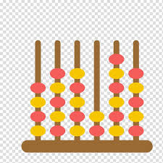
A for ABACUS

Slide 7

B for BAR GRAPH

Slide 8

C for CIRCLE

Slide 9

D for DECAGON

Slide 10
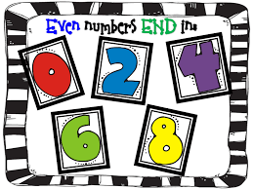
E for EVEN NUMBERS

Slide 11
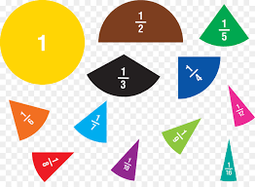
F for FRACTION

Slide 12

G for GEOMETRY

Slide 13
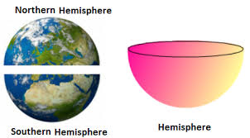
H for HEMISPHERE

Slide 14

I for INFINITY

Slide 15
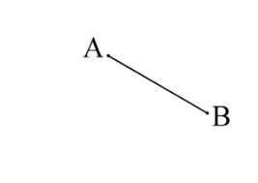
J for JOINING OF TWO POINTS

Slide 16

K for KILO

Slide 17
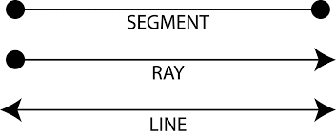
L for LINE

Slide 18

M for MENSURATION

Slide 19
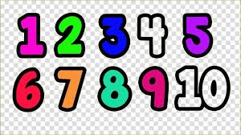
N for NATURAL NUMBER

Slide 20

O for OCTAGON

Slide 21
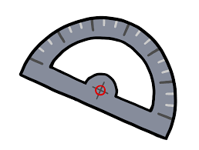
P for PROTRACTOR

Slide 22
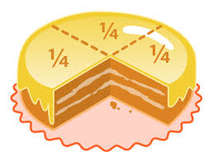
Q for QUARTER

Slide 23
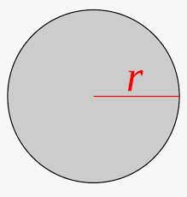
R for RADIUS

Slide 24
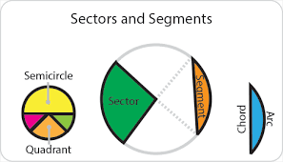
S for SECTOR OF CIRCLE

Slide 25

T for TANGRAM

Slide 26


U for UNEQUAL

Slide 27
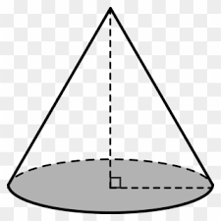

V for VERTEX

Slide 28
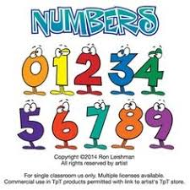
W for WHOLE NUMBERS

Slide 29
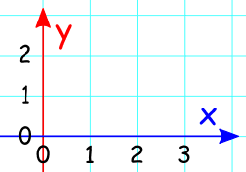
X for X - AXIS

Slide 30
Y for Y - AXIS

Slide 31

Z for ZERO

