Slide 1
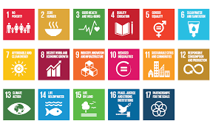
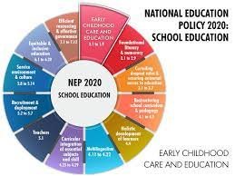
Integration of UNSDGs &NEP 2020

Slide 2
The Sustainable Development Goals given to the world by the United Nations are based on what we need to survive in a better world. In the Agenda 2030, there are 17 Global Goals The National Education Policy 2020 (INDIA) has mentioned the SDGs and has given a call to align education in India to these goals.

Slide 3
The National Education Policy (NEP) 2020 aims to make education
accessible
equitable
holistic
for all, with a focus on student-centric and learning-centric approaches

Slide 4
The NEP 2020 aligns with several of the United Nations Sustainable Development Goals (UNSDGs) in the following ways:
Quality Education (SDG 4): The NEP 2020 aims to improve the quality of education in India by focusing on student-centric and learning-centric approaches, increasing investment in education and promoting inter-disciplinary studies.
Gender Equality (SDG 5): The NEP 2020 emphasizes the need for gender sensitivity and inclusion in education, and aims to reduce gender disparities in enrollment and completion rates

Slide 5
Decent Work and Economic Growth (SDG 8): The NEP 2020 emphasizes the need for skill-based education and vocational training to improve employability and contribute to the economic growth of the country.
Sustainable Cities and Communities (SDG 11): The NEP 2020 stresses the importance of environmental education and sustainability, and encourages schools and colleges to incorporate these values into their curricula.
Partnership for the Goals (SDG 17): The NEP 2020 emphasizes the need for partnerships between the government, private sector, civil society and communities to achieve its goals.

Slide 6
The 17 sustainable development goals (SDGs) to transform our world:
GOAL 1: No Poverty
GOAL 2: Zero Hunger
GOAL 3: Good Health and Well-being
GOAL 4: Quality Education
GOAL 5: Gender Equality
GOAL 6: Clean Water and Sanitation
GOAL 7: Affordable and Clean Energy
GOAL 8: Decent Work and Economic Growth
GOAL 14: Life Below Water
GOAL 9: Industry, Innovation and Infrastructure
GOAL 10: Reduced Inequality
GOAL 11: Sustainable Cities and Communities
GOAL 12: Responsible Consumption and Production
GOAL 13: Climate Action
GOAL 15: Life on Land
GOAL 16: Peace and Justice Strong Institutions
GOAL 17: Partnerships to achieve the Goal

Slide 7
The National Education Policy 2020 (INDIA) has mentioned the SDGs and has given a call to align education in India to these goals. The ball is in the classroom court now! Are we ready to align to the intent and the demands of SDG awareness?

Slide 8
Do plan the SDGs Mapping of the Curriculum so that the education we impart is related to the world we are teaching them for.
While you take a class tomorrow morning - keep one thought in mind:
Are you preparing them for the Present or the Future - they will exit into?
If future - here we are with Agenda 2030 and even if you read it as 'present' - Do something that Your Future self will be thankful for!

Slide 9
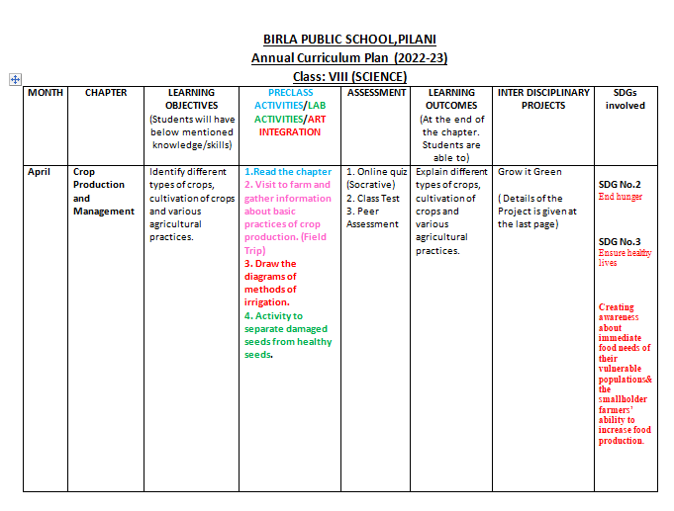

Slide 21
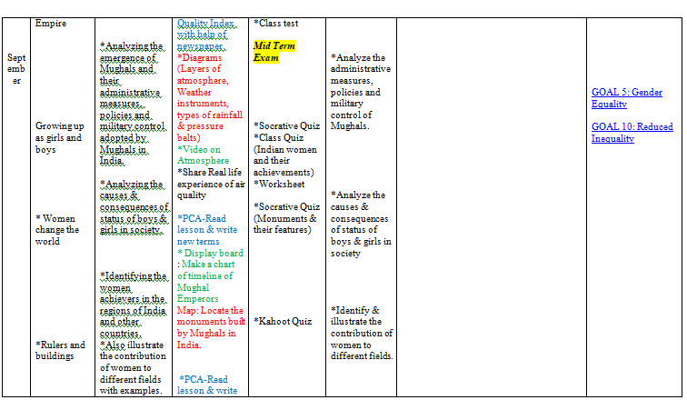

Slide 22
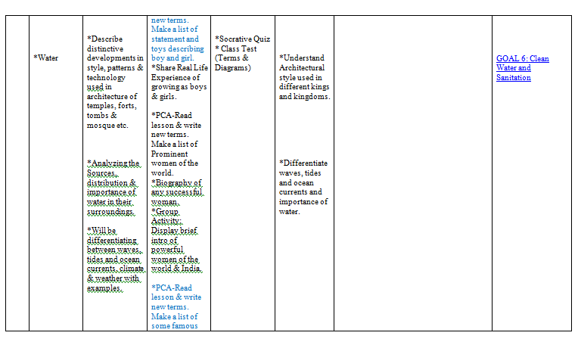

Slide 28
