Slide 1
TOY BASED LEARNING AND STORY TELLING AS PEDAGOGY
Presented By: Ms. Anu

Slide 2
You may be wondering, how children can learn if they’re just playing or listening stories all day?!
What do kids learn through play and stories?

Slide 3
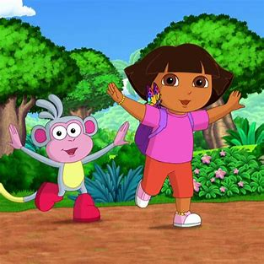
DORA
THE EXPLORER

Slide 4
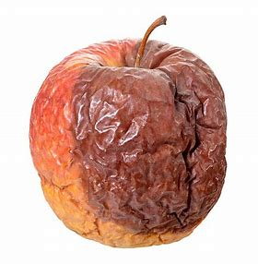

Slide 5
Story telling can be a powerful tool for teaching any subject with the help of these 4P’S OF story telling:
PEOPLE
PLACE
PLOT
PURPOSE

Slide 6
Big
Bigger
Biggest
Toy/Story based method of learning is a complete package that enables overall development of the child by developing in terms of feelings, intellect and skills parameters.

Slide 7
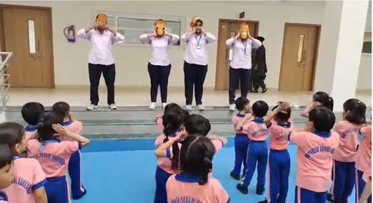
Kids involved in learning good habits through story telling.”
“Tell me and I’ll forget; Show me and I may remember; involve me and I’ll understand.”

Slide 8
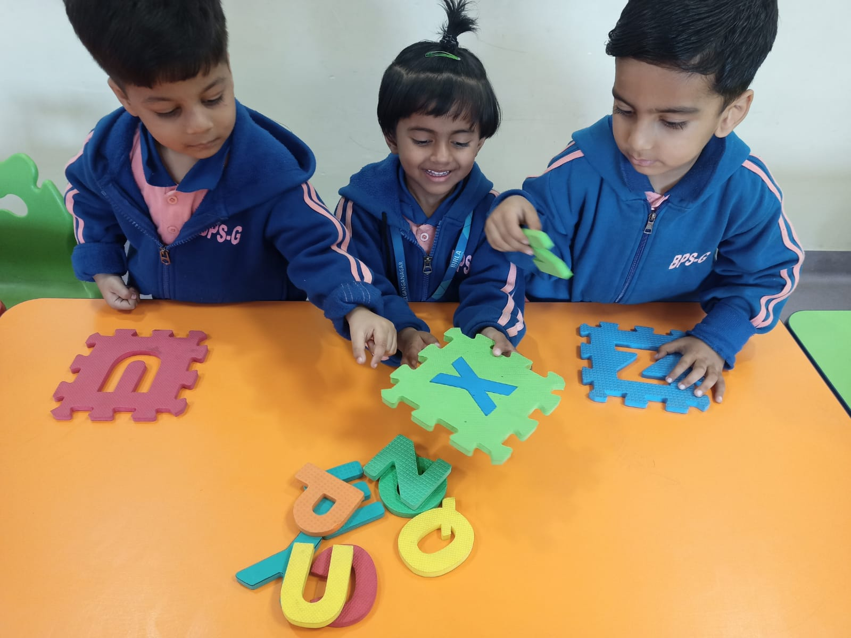
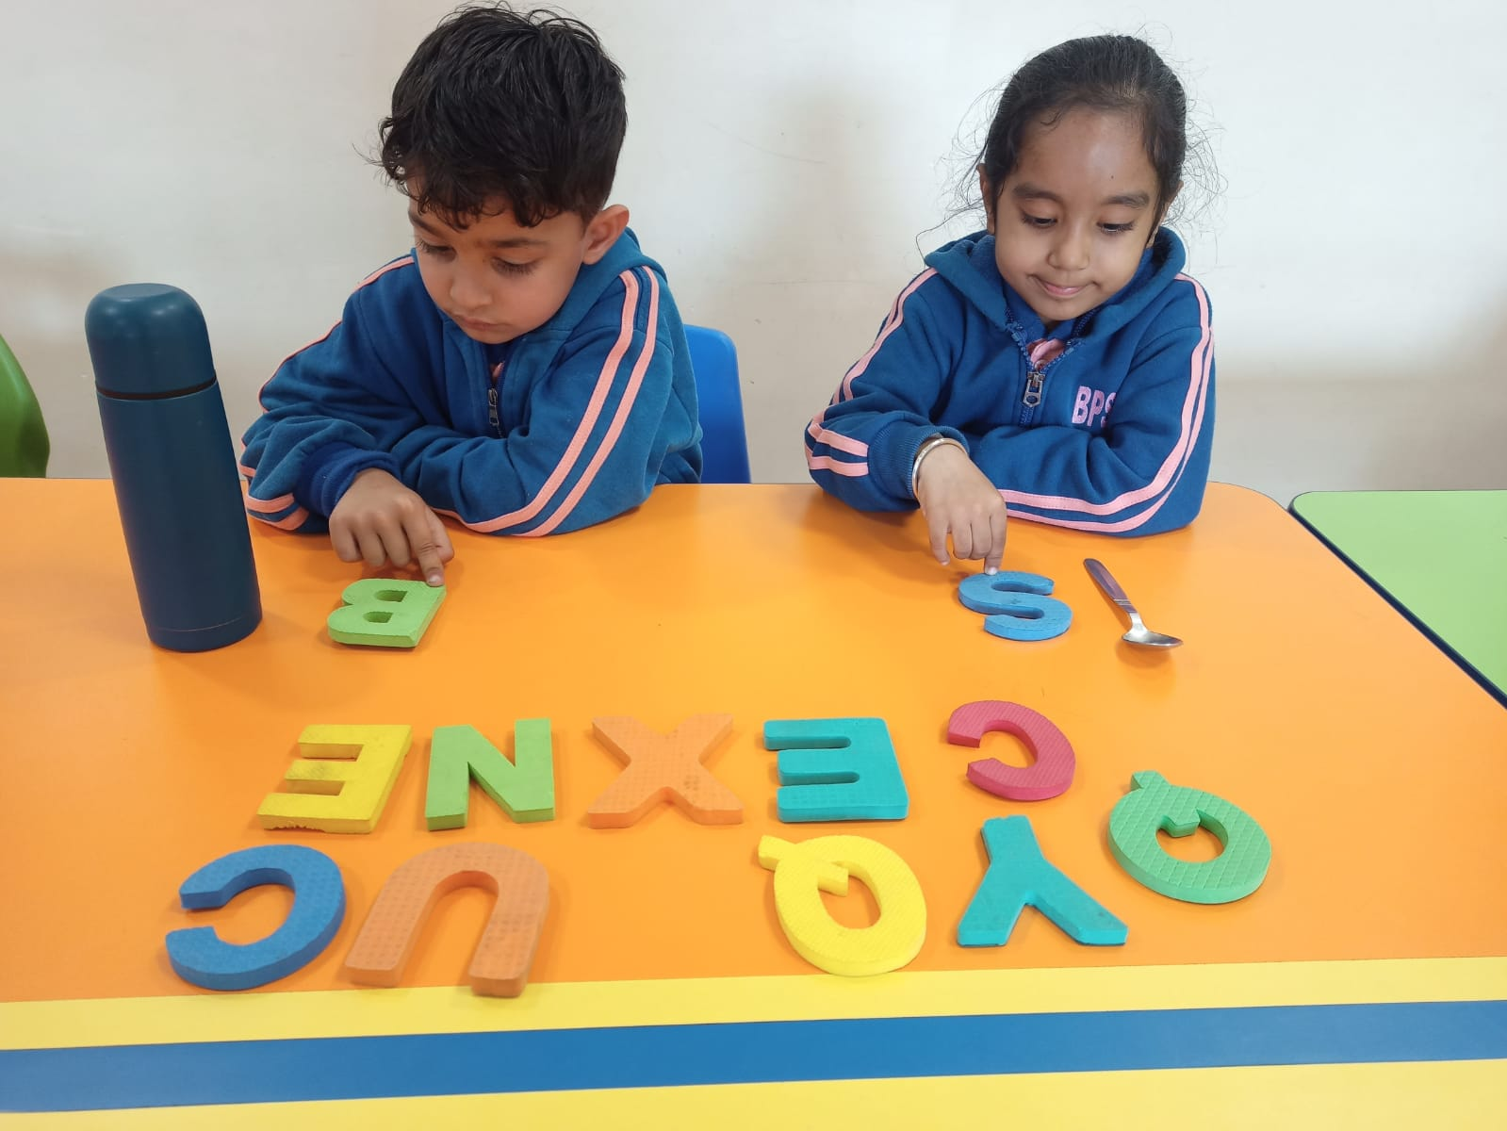
MATCH THE CORRECT LETTER
MATCH THE CORRECT LETTER

Slide 9
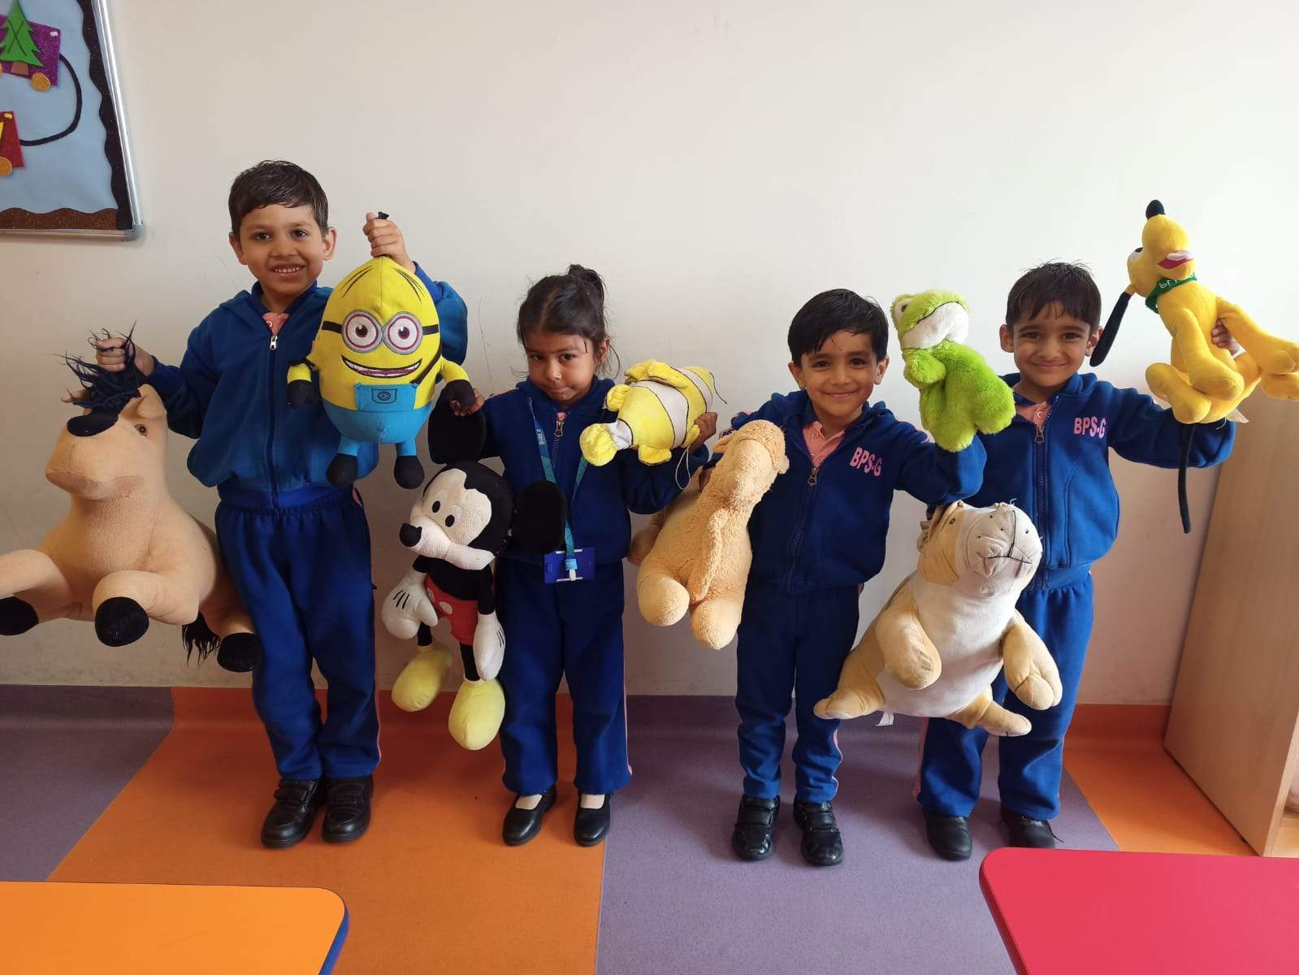
LEARNING CONCEPT OF HEAVY/LIGHT

Slide 10
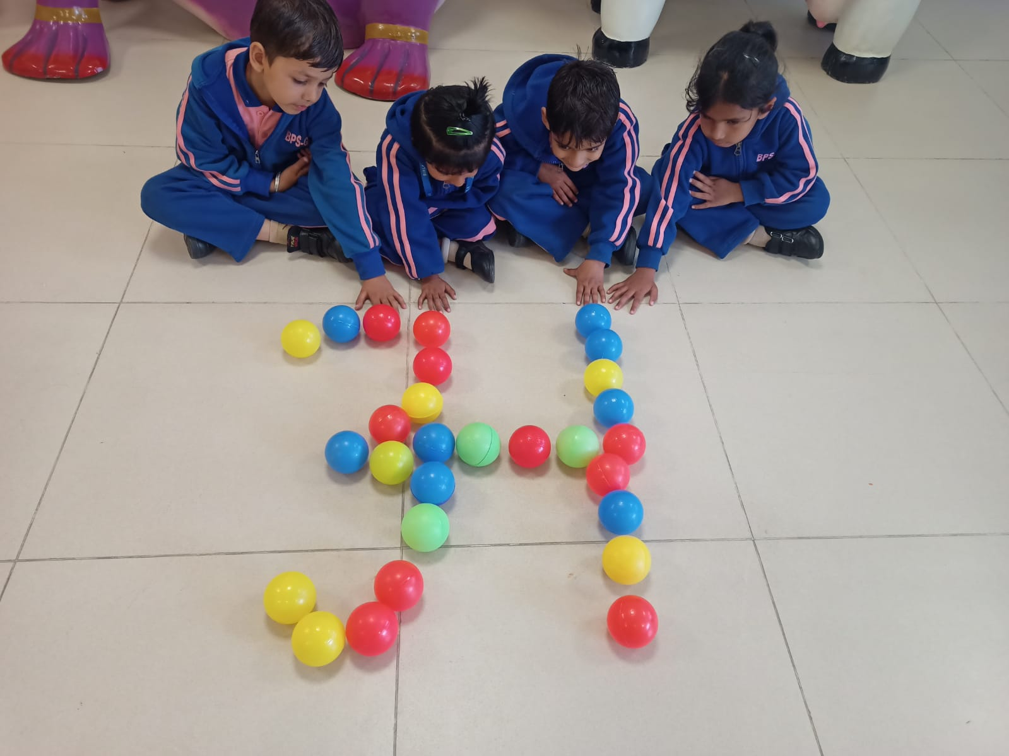
COUNTING BANGLES
LEARNING FORMATIONS WITH THE HELP OF BALLS

Slide 11
Are TOYS and STORYTELLING actually helping?
It is developing vocabulary.
It is building imagination and creativity.
It is improving literacy.
It is promoting physical fitness.
It is encouraging greater independence.
It is delivering emotional and behavioral benefits.
Playing with toys is fostering cognitive growth.

