Slide 1
NINETH 'ONE-DAY' ANNUAL CONFERENCE OF BET TEACHERS
Analyzing Children’s Responses for Effective Teaching-Learning
Pratibha Yadav

Slide 2
NCF SAYS
3 Year
4 Year
6 Year
5 Year
7 Year
8 Year
Foundation stage :
Domains
Physical Development
Socio Emotional and Ethical Development
Cognitive Development
Aesthetic and Cultural Development
Language and Literacy Development
Foundation stage : Nursery, Kg. Prep, Class I and Class II

Slide 3
Analyzing Children’s Responses for Effective Teaching-Learning
Chapter 6 – Assessment for further learning
Section – 6.3

Slide 4
Eliciting the evidences of child's learning
1
Analyzing and interpreting the responses
2
Acting upon the evidence
3

Slide 5
Pre-requisites for analyzing evidence from assessment
Open mind
Design
Execute
Collection

Slide 6
Principles for analyzing evidence from assessment
What they know?
What extent do they know?
How they know?
How do you know?
What do you Know?

Slide 7
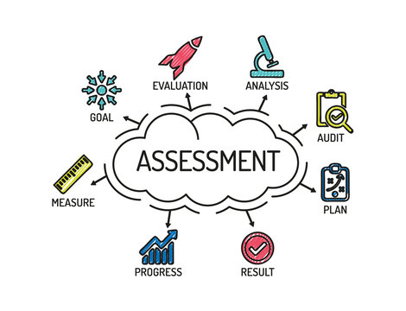
Acting upon the analysis
Revise
Plan B
Identify

