Slide 1
DEMYSTIFYING THE APPROACHES
FOR HOLISTIC AND
MULTIDISCIPLINARY LEARNING
25 Feb 2023
JYOTI TIWARI, Headmistress
BIRLA PUBLIC SCHOOL, KISHANGARH

Slide 2
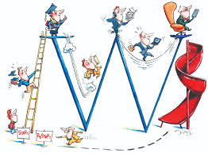
HOLISTIC EDUCATION:
THE CORE OF NEP 2020
CRIBBING LEARNER
SHIFT
CHANGE MAKER
TO CREATE LIFE LONG LEARNERS
LEARN FROM THEIR ERRORS
FOCUS TOWARD THE LIFE SKILLS, ATTITUDES, AND PERSONAL AWARENESS
TO DEVELOP A LEARNER’S SOCIAL AND ACADEMIC MATURITY TO ACCEPT LIFE’S CHALLENGES

Slide 3
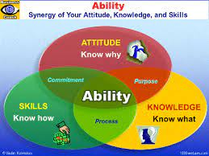
PARADIGM SHIFT…
SHIFT IN CURRICULUM : What to learn?
SHIFT IN PEDAGOGY: How to learn?
SHIFT IN ASSESSMENT: How to assess?

Slide 4
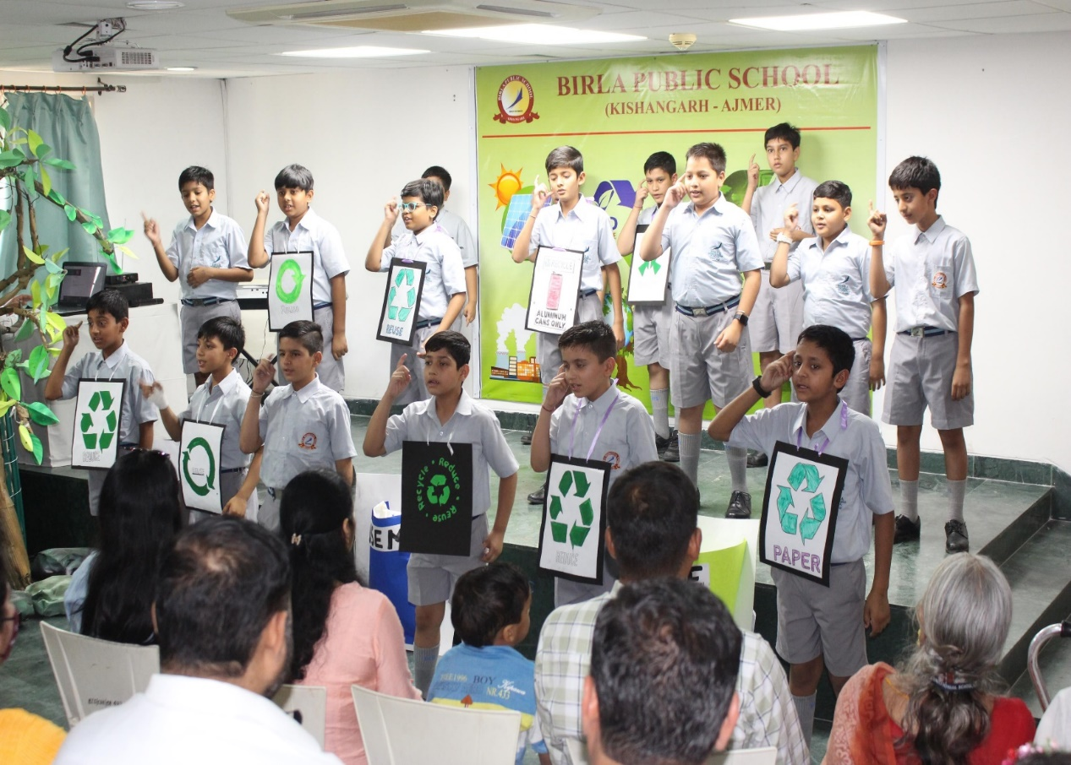
DEMYSTIFYING APPROACHES…
PROBLEM SOLVING IN COLLABORATIVE SETTING
KNOWN TO UNKNOWN
*INQUIRY BASED APPROACH
*PROJECT BASED LEARNING
1.TUNING
IN
2.FINDING OUT
3.SORTING
OUT
4.GOING
FURTHER
5.MAKING CONNECTION
6.TAKING
ACTION

Slide 5
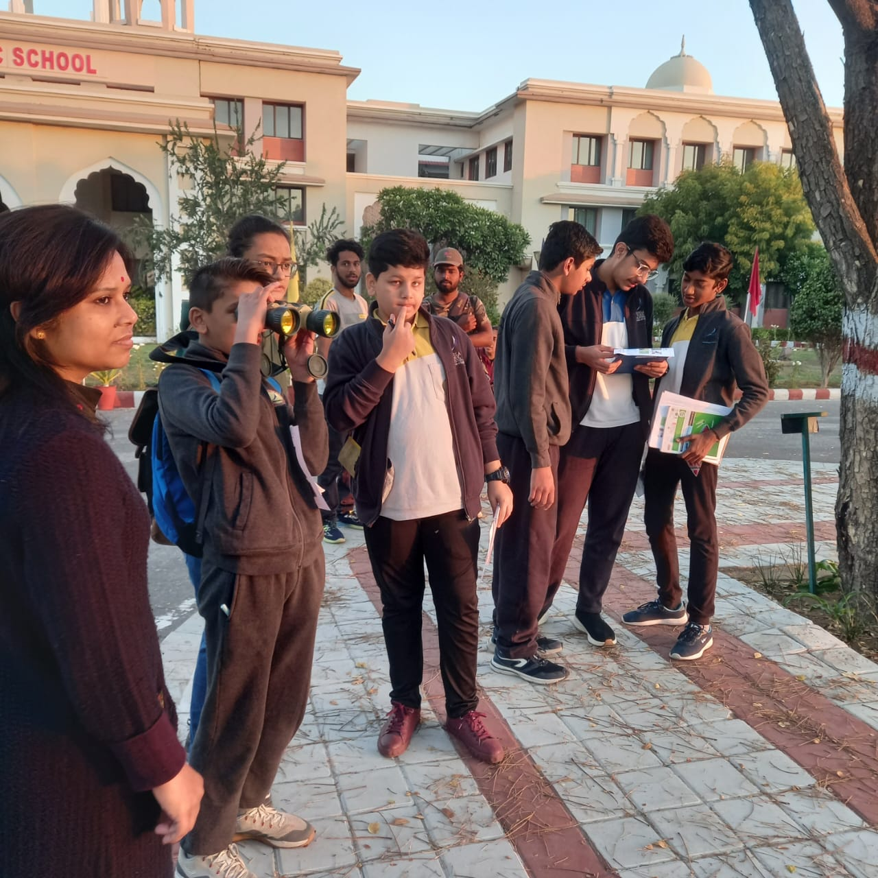
DEMYSTIFYING APPROACHES…
Reflective Observation
Concrete Experience
Abstract Conceptualization
Active Experimentation
EXPERIENTIAL LEARNING
INTEGRATED PROJECTS

Slide 6
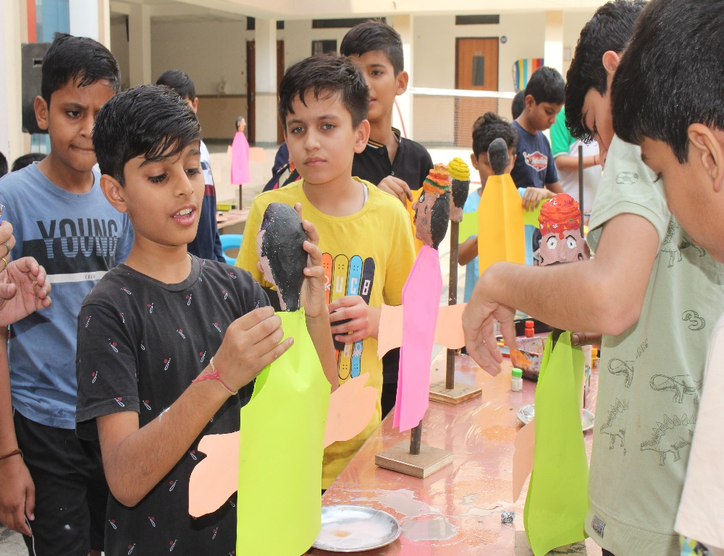
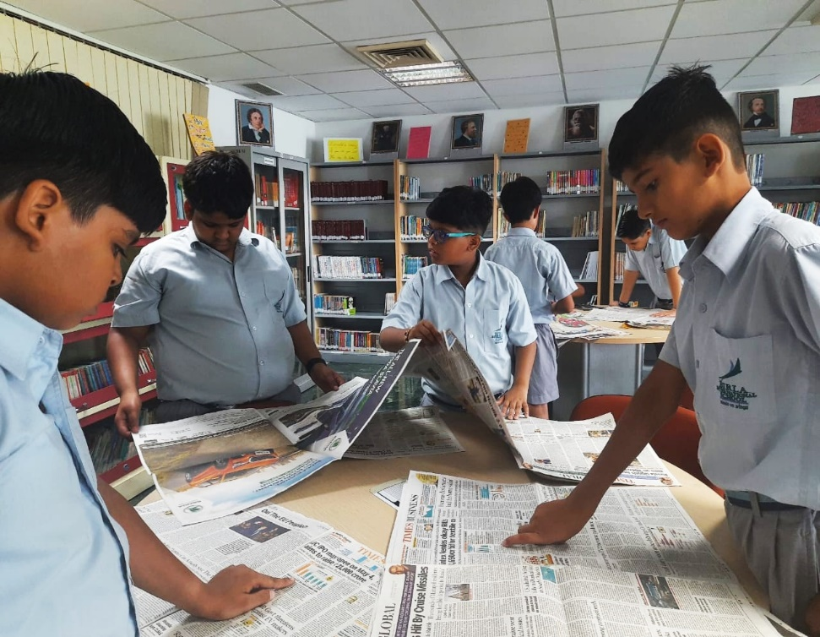
DEMYSTIFYING APPROACHES…
*STORY TELLING PEDAGOGY
*imagination
*emotional involvement
*logical
*content retention
*scientific temperament
*language enhancement
*unknown to known
*ANALYSIS BASED APPROACH

Slide 7
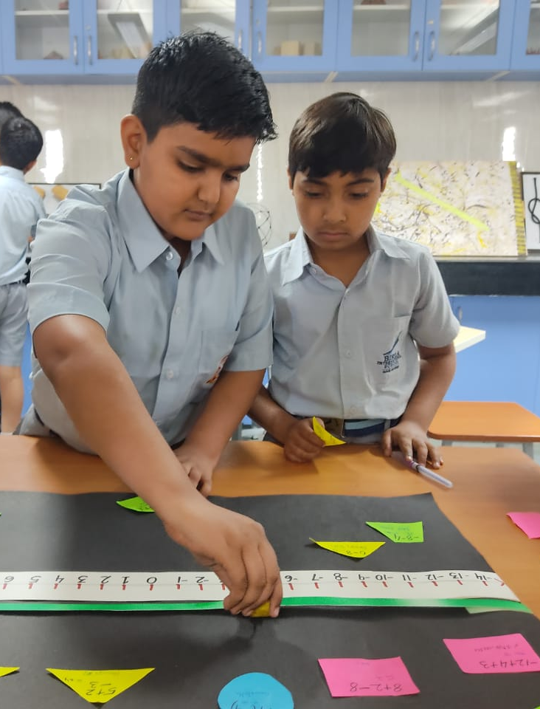
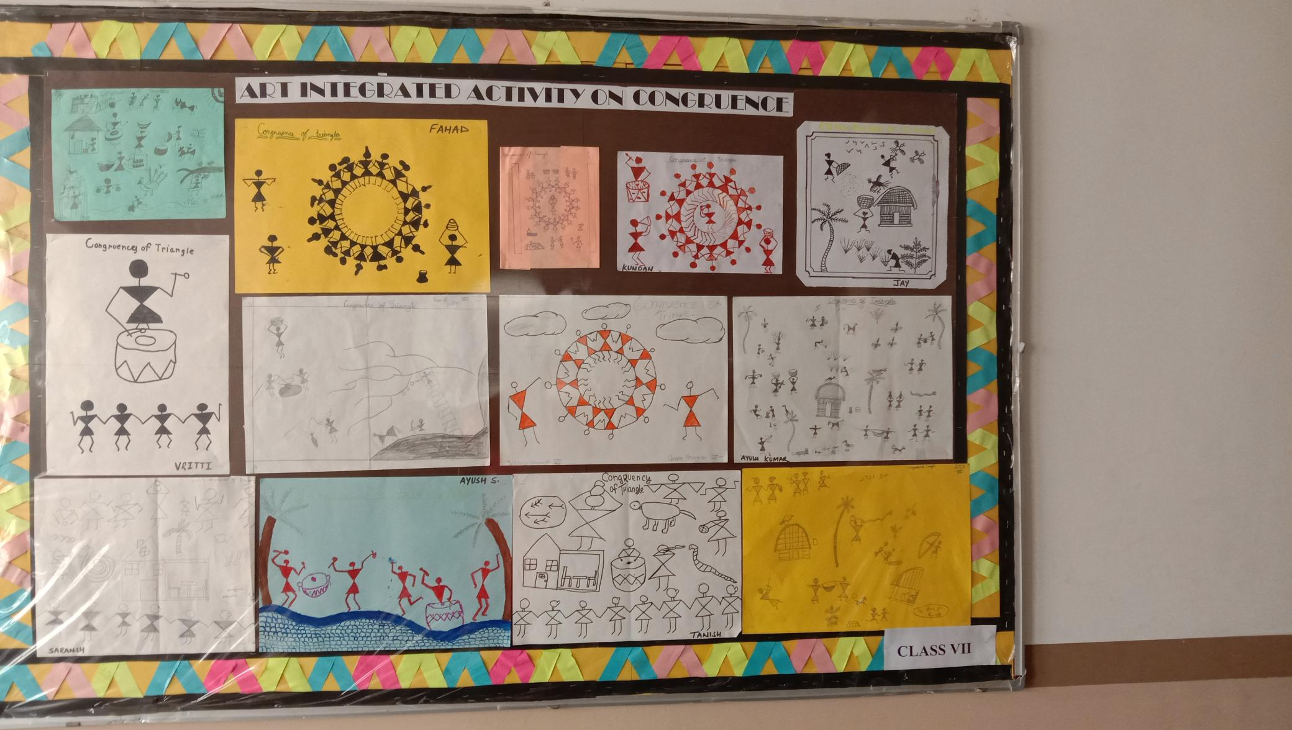
DEMYSTIFYING APPROACHES…
*constructivist approach
*ART INTEGRATION
*learning
through
art
*inquiry
*exploration
*learning
with
art
*getting answers from the prompt
*decision
making
*allowed to make mistake and correct it
*critical
thinking
*active learning
*problem
solving
*DISCOVERY BASED

Slide 8
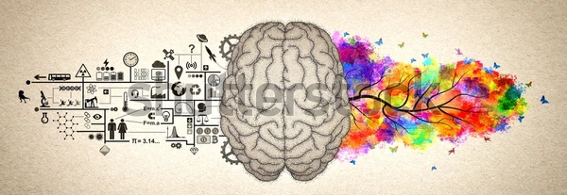
Let’s sum it up…
RESEARCH DRIVEN
SKILL FOCUSED (21ST CENTURY SKILLS)
COLLABORATIVE
PROBLEM SOLVING
DEVELOPING THINKING CULTURE
REFLECTIVE LEARNING
STUDENT CENTRIC
SHIFT OF LEARNING FROM LOTS TO HOTS
PROVIDE AN OPPORTUNITY FOR COGNITIVE, AFFECTIVE AND PSYCHOMOTOR DOMAIN OF LEARNING

Slide 9
ACTION PLAN – WAY FORWARD…
1.CURRICULUM MAPPING
2. CONCEPT MAPPING
3. CONTENT MAPPING
4.SKILLS MAPPING
5.ASSESSMENT PLANNING
6.COLLABORATIVE PLANNING

Slide 10
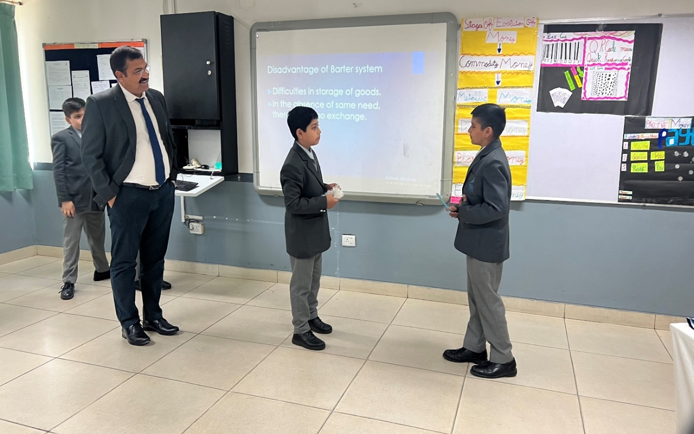
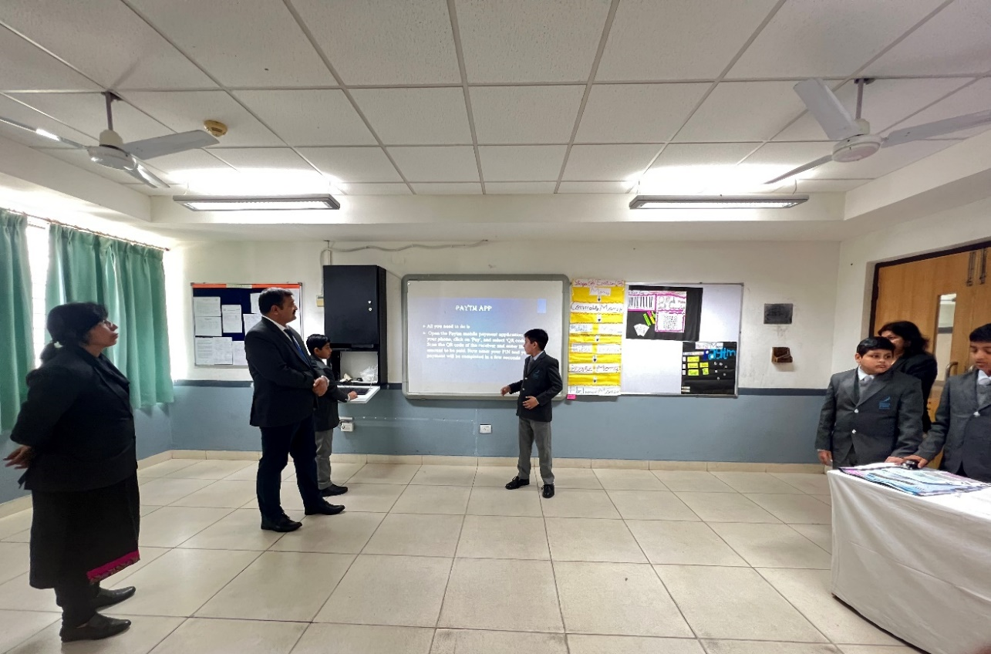
INQUIRY PROJECTS AT BPSK – CLASSES V - VIII
GLIMPSES
EVOLUTION OF MONEY BY CLASS V
BARTER SYSTEM
TO PAPER MONEY
TO PLASTIC MONEY
TO ELECTRONIC TRANSACTION
K+A+S

Slide 11
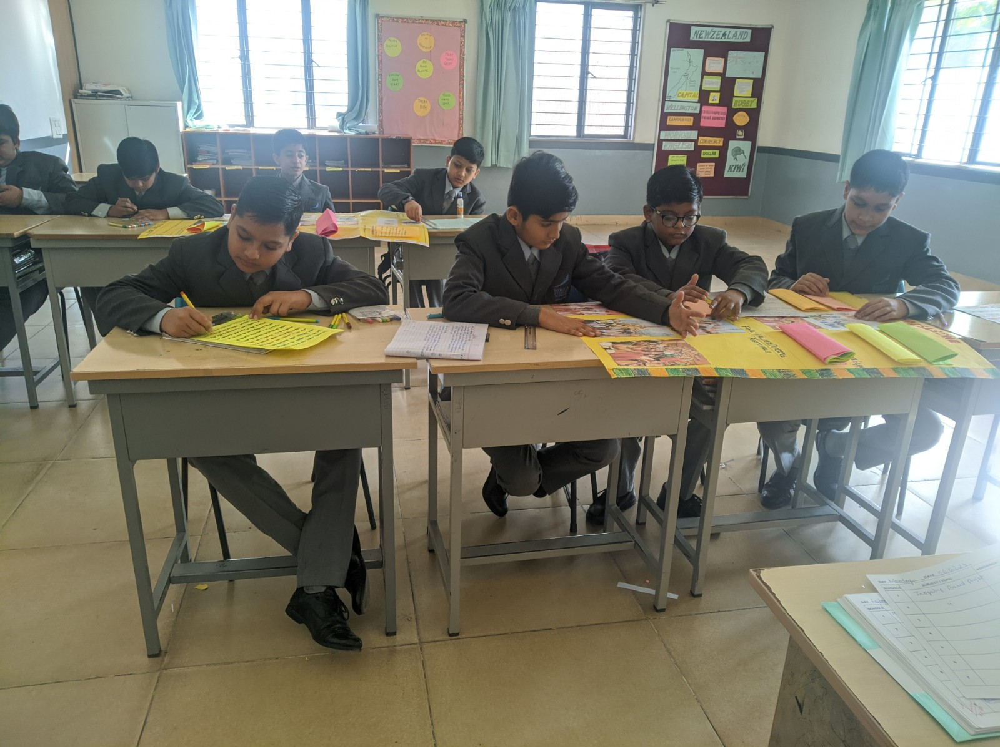
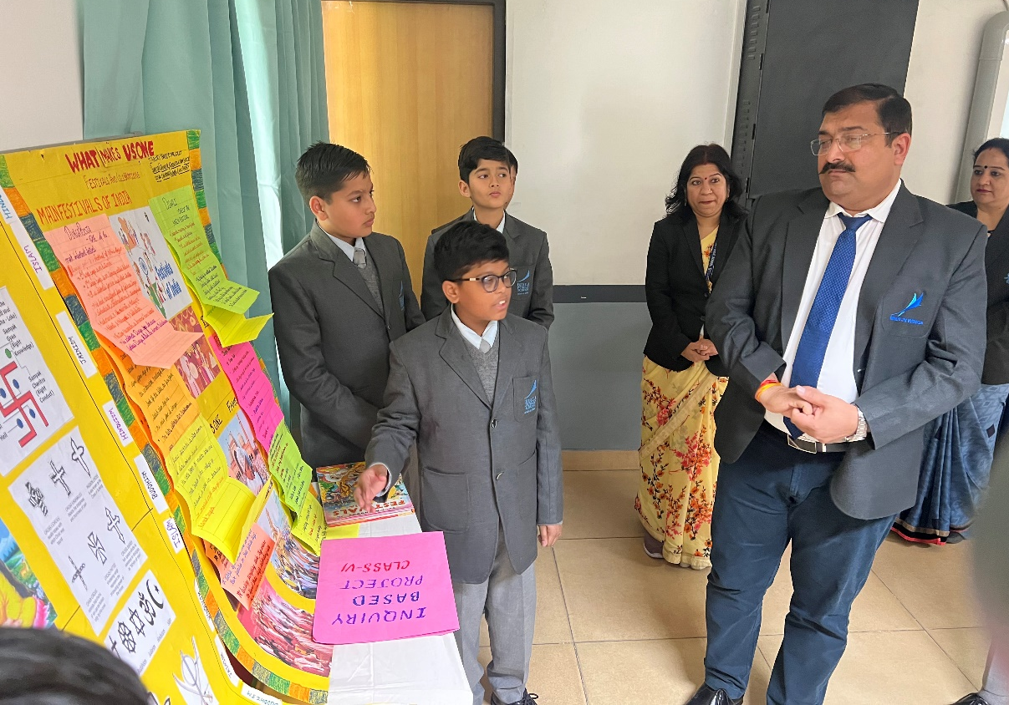
INQUIRY INTO WHAT MAKES US ONE! BY VI
VALUES
TRADITIONS
FESTIVALS
COLLABORATION
K+A+S
PRESENTATION

Slide 12
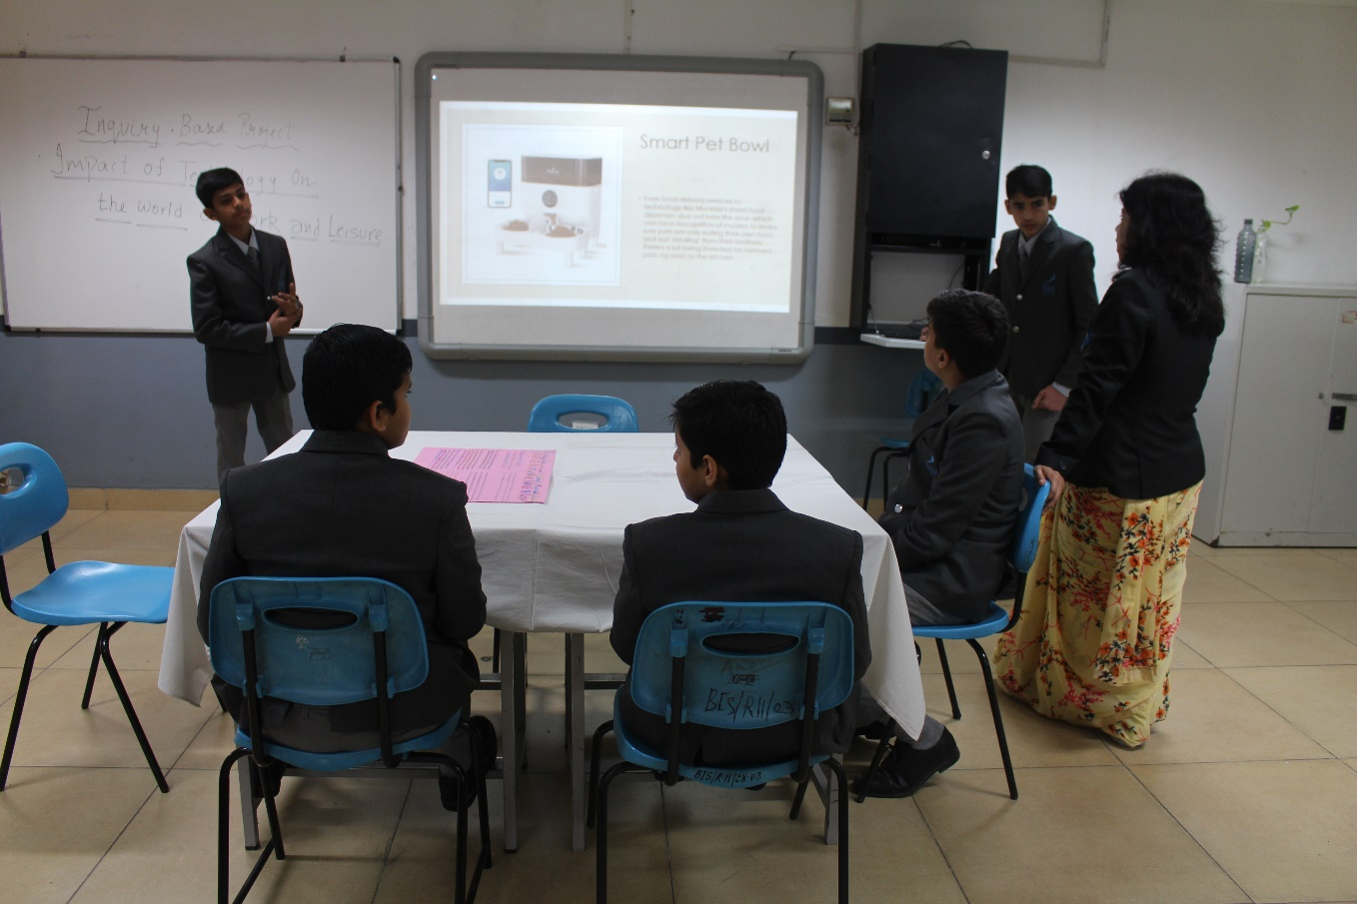
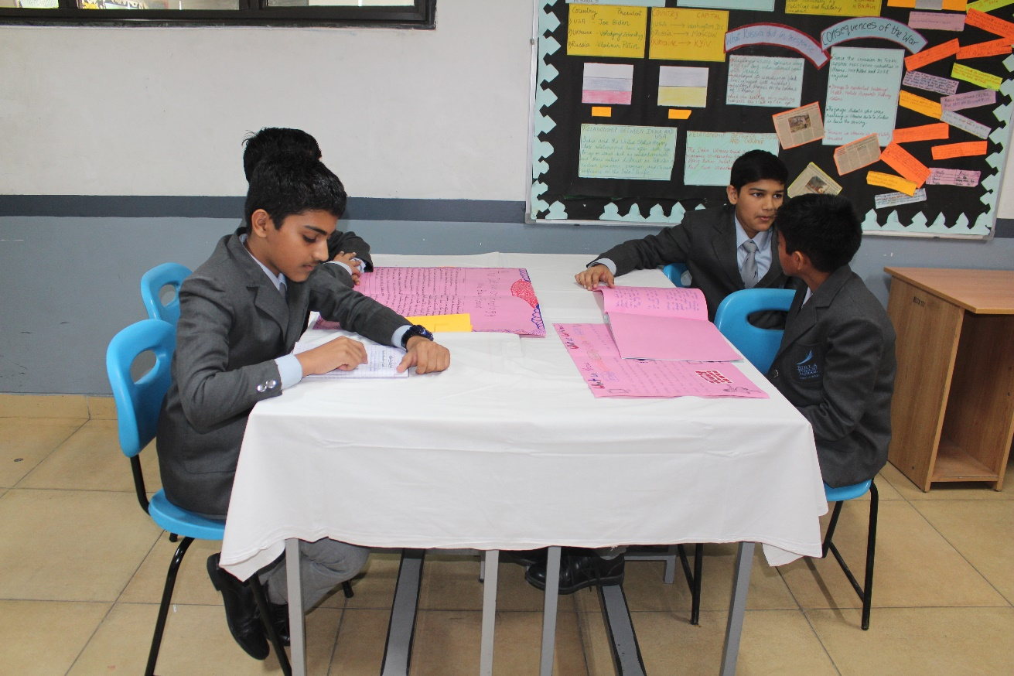
INQUIRY INTO IMPACTS OF TECHNOLOGY AT
WORK PLACE, HOME AND LESIURE BY VII
DISCOVERIES – FIRE, WHEEL, ELECTRICITY
NEGATIVE IMPACT OF TECHNOLOGY
ERP AT WORK PLACE
ONLINE GAMES
K+A+S
GADGETS AND FURNITURE IN MODERN KITCHEN AND AT HOME

Slide 13
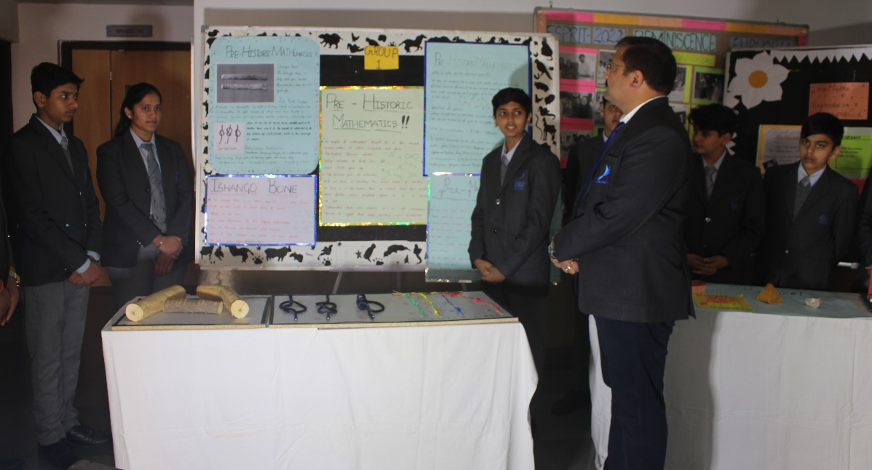
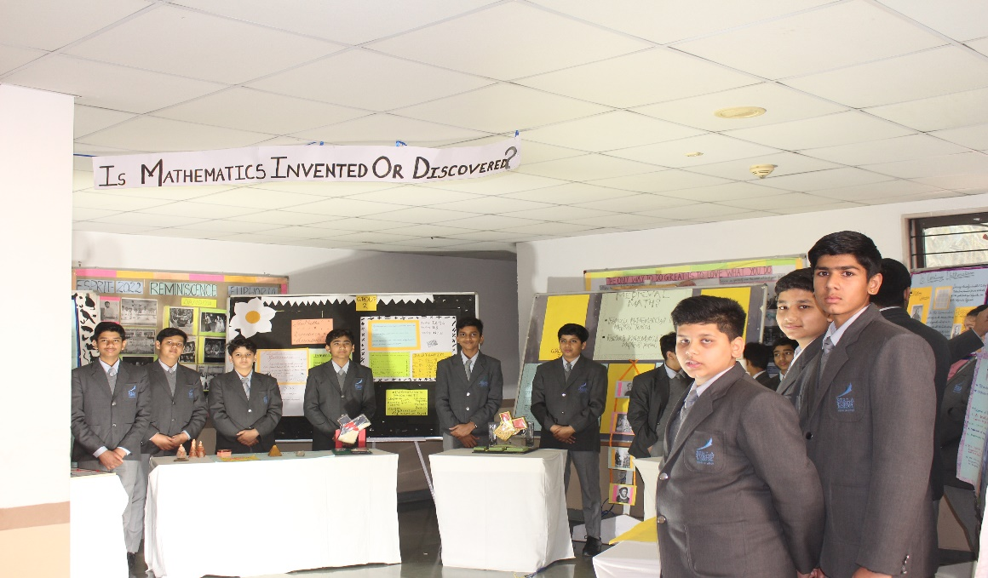
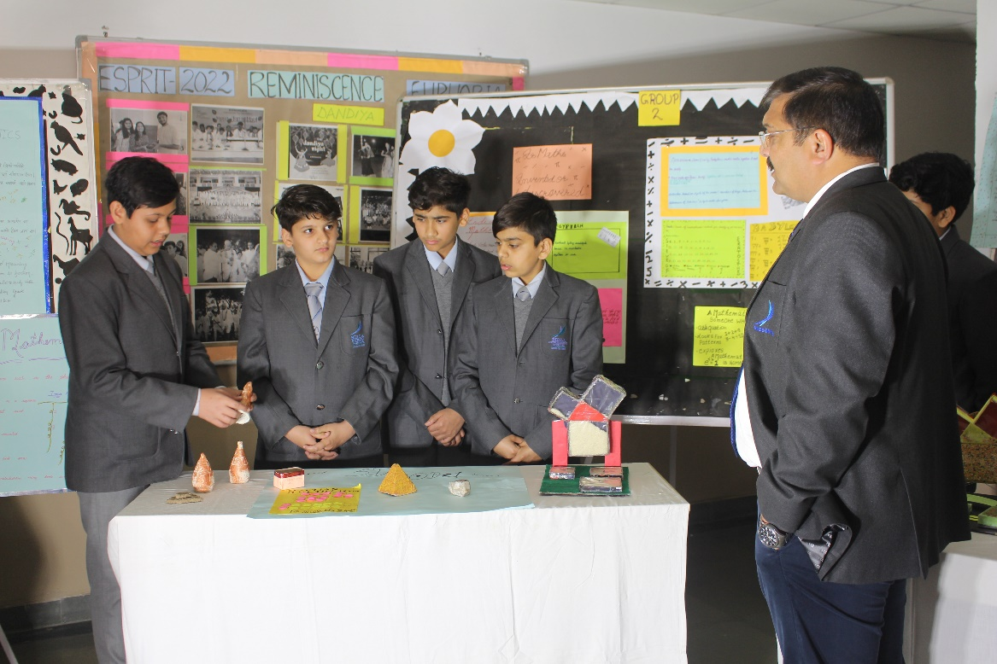
MATHEMATICS – A DISCOVERY OR INVENTION BY CLASS VIII
GOLDEN RATIO
PREHISTORIC MATHEMATICS
K+A+S
MATHS IN ANCIENT CIVILIZATIONS
INDIAN MATHEMATICIANS

Slide 14
THANK YOU!
Education is learning what you didn’t even know you didn’t know…
Daniel J Boorstin

