Slide 1
Inculcating Ethics & Constitutional Values among THE Learners -THROUGH THE LENS OF NEP 2020
By RAJAN KUMAR
(BIRLA SCHOOL, PILANI)

Slide 2
Ethics and Values
These are firm beliefs and ideals held by a person which determine his/her thoughts and actions.
These are the guiding principles which provide basis for individual choices in life.

Slide 3
Values – the Cornerstones
Not to be treated as ideal concepts
Are “empowering tools”
Helpful in meeting the challenges of the contemporary social world
Empower the students with certain attitudes and skills
Help in facing the myriad challenges

Slide 4
nep 2020 : The Values to Reckon

Slide 5
Ethics and Values Enlisted in NEP 2020
Empathy
Respect for others
Courtesy
Democratic Spirit
Spirit of service
Respect for public property
Responsibility
Mutual Respect

Slide 6
Constitutional Values
Justice
Equality
Fraternity
Freedom
Unity of the Nation
Secularism
Protection of Natural Environment
Scientific Temper
Preservation of heritage and culture

Slide 7
ETERNAL VALUES
Peace /Harmony
Happiness
Goodness
Aesthetic Sense
Knowledge

Slide 9
Why to incorporate Values in Education?

Slide 10
NEP 2020 and Inculcation of Values
Total education should aim at providing knowledge, skills and values leading to holistic development of the individual .
School going years are the formative years in everyone’s life. Habits, beliefs and attitudes acquired during this period become one’s roots and cornerstone for thoughts, choices and actions in later life.
School education is, in its broader interpretation, preparing students for their adult life so that they become balanced individuals, responsible citizens and useful individuals of society. This would be incomplete without values education.

Slide 11
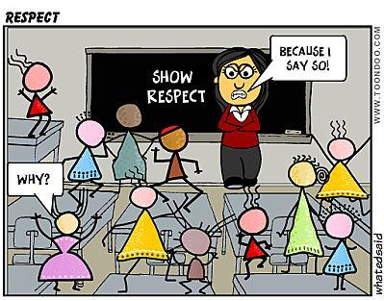

Slide 12
Integrating Values in the Curriculum

Slide 13
A Framework for Conducting a Value Education Activity
Introducing a conflict situation
Identifying the challenges
Proposing suggestions
Using reasoning for analysing arguments
Conclusion and Evaluation

Slide 14
Integrating Values into the Curriculum
Values :
Can not be taught like a subject i.e. Languages, History, Science or Mathematics
Should be inculcated through the situations deliberately planned while teaching various school subjects
Poems, stories, examples of great & noble persons, group discussions, debates, case studies
Co-scholastic activities, games and sports etc are few examples for inculcating values

Slide 15
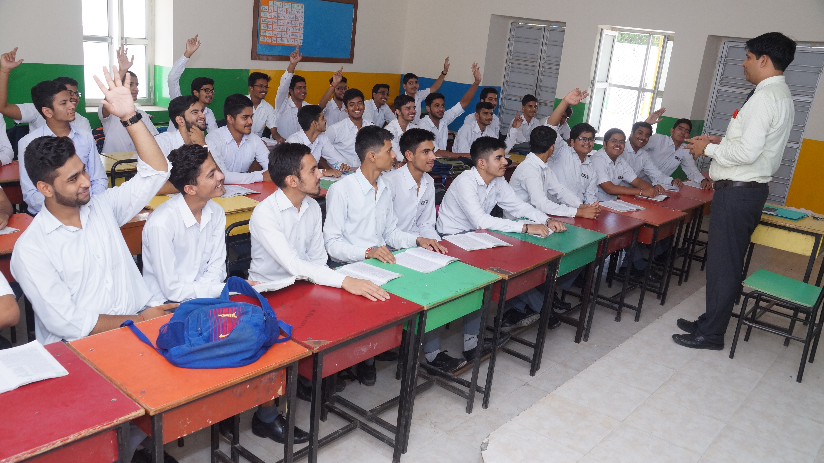
The Role of Teacher
It is necessary that the teacher plans each lesson keeping in mind the following:
Identify the values of each lesson keeping the lesson objectives and learning outcomes in mind.
Develop a strategy to communicate, identifying concepts and the processes and modes of dissemination of values.
Devise creative mechanisms to communicate these to the students.
Reflect and discuss the efficacy of efforts by reviewing impact on affective behaviour keeping in mind the components of Values Education.
The teachers must, however bear in mind the stage appropriateness, the time available and the objectives and learning outcomes of the lesson while transacting values.

Slide 16
The 5 Steps Approach
Knowing – introducing the learner to the inherent values while going through a particular topic/situation
Making judgments – providing with conflicting situations while teaching to enable the learner to evaluate the implications of the related values
Believing – emphasing the relevant points helpful in development of faith in these related values.
Action – encouraging to practise these values in actual life situations as a result of change by relevant and meaningful experiences
Internalization – leading the learner to a stage where the practice of acquired values may be spontaneous and immediate resulting in desired outcomes

Slide 17
Whole School Approach for Values Education
Value Education need to be woven into the entire academic calendar comprising
Interactive practices
Interpersonal relationships/ student exchange
School activities
The way events are celebrated
Community outreach
The harmony within self and others around
Spaces for experiential learning where students explore, think, reflect and internalize positive values.
Feedback and regular reinforcement.

Slide 18
Ways to incorporate Values in School Curriculum
Morning assembly presentations
Role Play
Clubs and Societies
School House Council
Reading and Research Programmes
Projects
Debates on Value based topics
Offering Social Services on voluntarily basis
Video documentaries on inspirational luminaries of India

