Slide 1
LEVERAGING TECHNOLOGY FOR EFFECTIVE IMPLEMENTATION OF NEP 2020 IN CLASSROOMS
NINTH ‘ONE-DAY’ ANNUAL CONFERENCE OF BET TEACHERS
ON PROGRESSIVE EDUCATIONAL PRACTICES
Theme: NEP 2020 ACTION PLAN FOR BET SCHOOLS
Sub. Theme: Schools of Tomorrow with Special Reference to Residential Schools.
Presented by: SHOBHIT DAGA
PGT (Computer Science)
BIRLA BALIKA VIDYAPEETH, PILANI

Slide 2
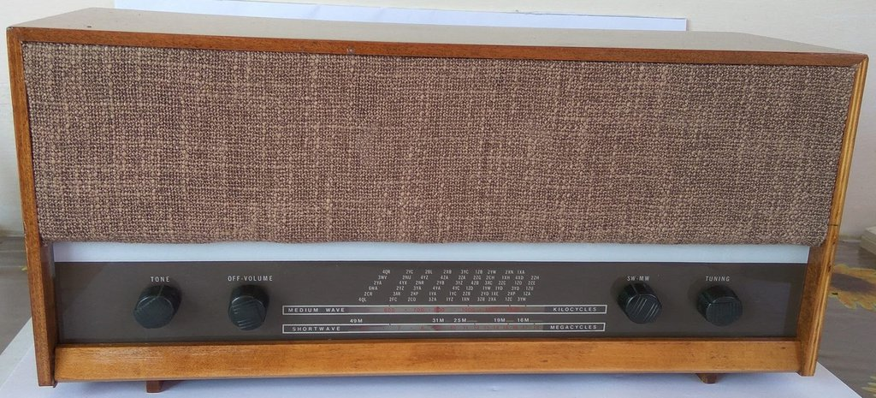
1963 Murphy MD58

Slide 3
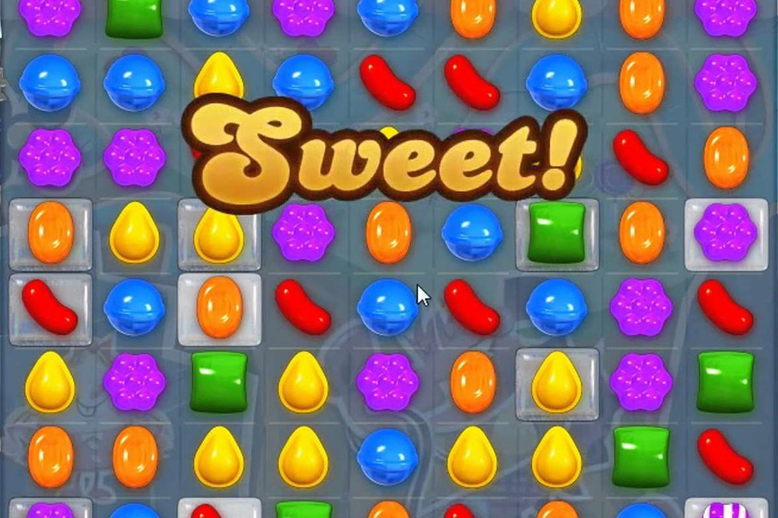
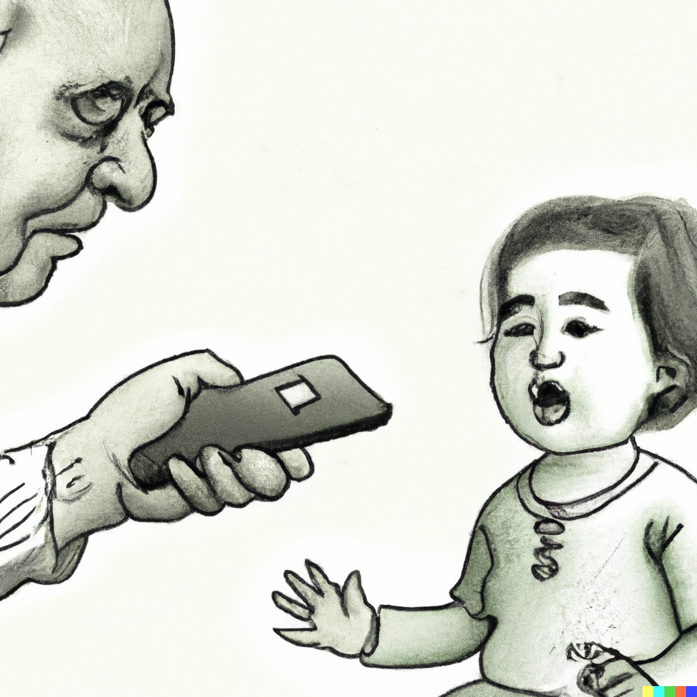
Candy Crush Saga

Slide 4
DIGITAL CHILDHOODS
The Landscape of Digital Opportunity

Slide 5
FROM
PIONEERS
TO INHABITANTS
Making ICT a core competency in BET Teachers

Slide 6
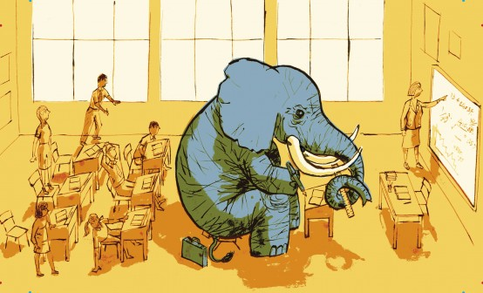
HOLDING CHILD’s ATTENTION
Using NEP 2020 to Address the Elephant in the Room

Slide 7
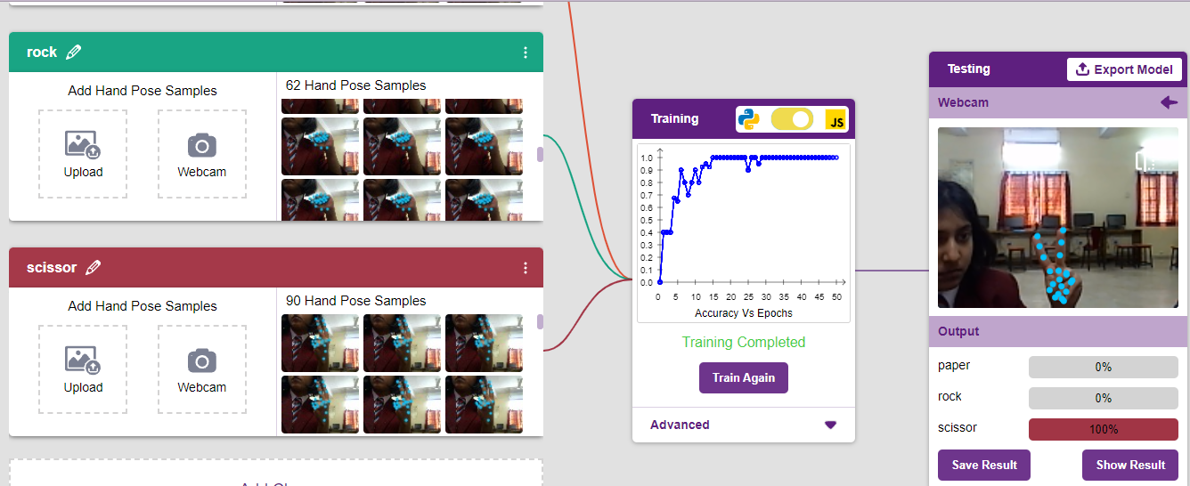
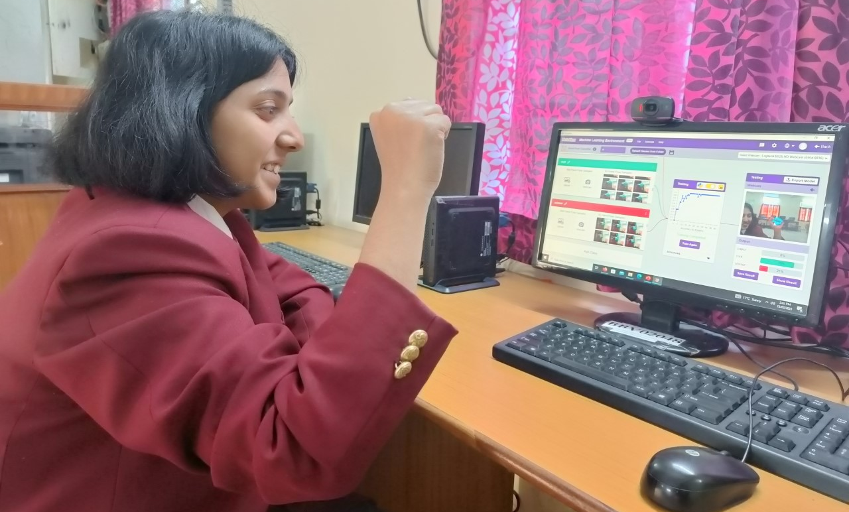
21st CENTURY LEARNER
Harnessing Technology to its Fullest

Slide 8
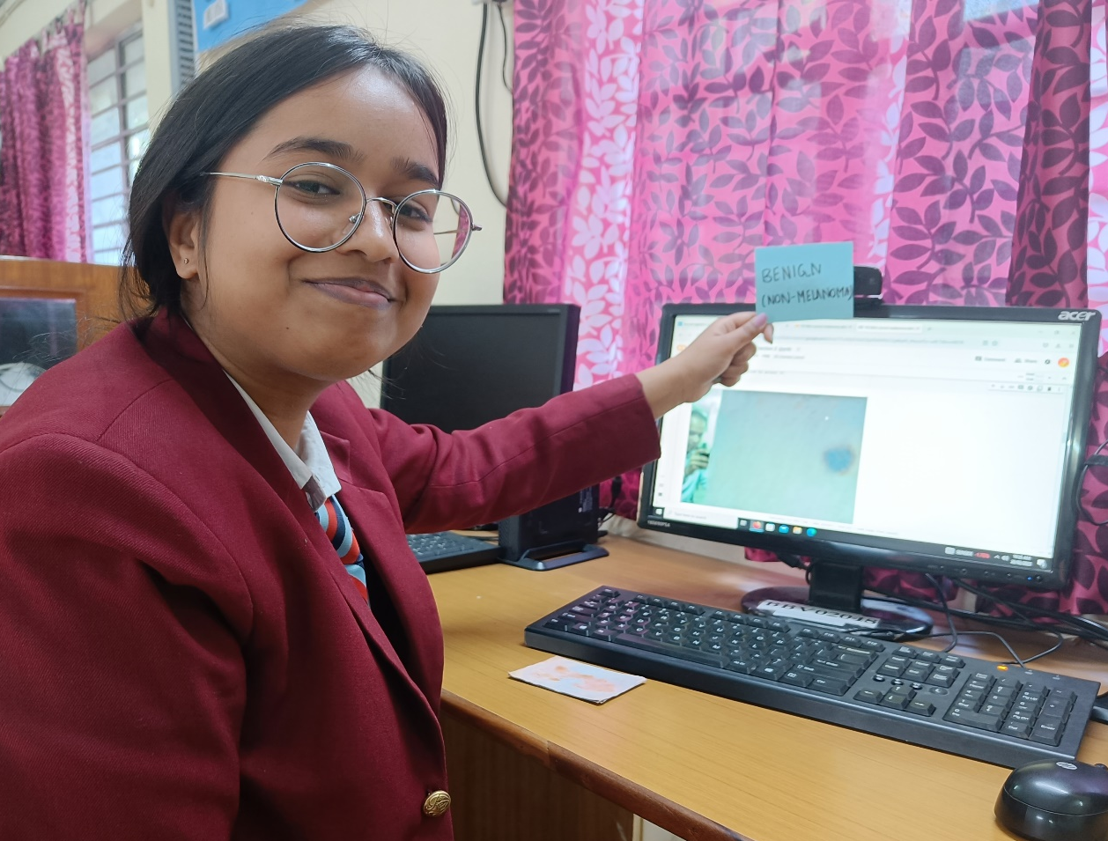
21st CENTURY LEARNER
Harnessing Technology to its Fullest

Slide 9
THE WORLD IS YOUR OYSTER
Vasudhaiva Kutumbakam

Slide 10
The Dogmas of the Quiet past are inadequate for the stormy present.
The occasion is piled high with difficulty.
We must rise to the occasion.
THANK YOU
BIBLIOGRAPHY:
https://www.education.gov.in/
https://www.anonymouslyzara.com/
https://www.hbs.edu/
https://openai.com/

