Slide 1
The Development of Early Childhood Care and Education in India through an eye of NCF-2022
NINETH
‘ONE-DAY’ ANNUAL CONFERENCE OF BET TEACHERS February 25, 2023
Presented by Mr. Pavan Vashishtha
Principal
Birla Shishu Vihar
Pilani

Slide 2
About the National Curriculum Framework
National Curriculum Framework (NCF) for the Foundational Stage
Developed to enable implementation of the National Education Policy (NEP) 2020
Helps develop diverse Curricula in the country, while enabling consonances & harmony across the country and providing a basis for quality and equity.
Objective
Positively transforming the school education system of India as envisioned in NEP 2020, through corresponding positive changes in the curriculum including pedagogy.
Characteristics of this NCF
1.
Developed for Teachers and Practitioners in education
2.
Lays down the new vision for schools
3.
Provides details and guidelines for quality education at Foundational stage

Slide 3
National Curriculum Framework (NCF) for the Foundational Stage
01
Five years of flexible, multilevel, play and activity-based learning for children from Ages 3 to 8
“First ever integrated Curricular Framework for children from Ages 3 to 8 in the country
02
Based on cutting-edge research from across the world
03
Rooted in India’s deep traditions and knowledge
04
Guide for Teachers and other Practitioners
05
Enables holistic development of all our children across institutions - Schools, Anganwadis, Balvatikas, Preschools

Slide 4
Fundamental Principles of the NCF
Every child is capable of learning
Families and Schools are partners in children’s learning
Care is central to learning
Continuous opportunities for children to experience, explore, and experiment with the environment are important for learning
Each child is different and grows, learns, and develops at their own pace
Play and activity are primary ways of learning and development
Children learn through observation, imitation, collaboration and concrete experiences
Children learn best when they are respected, valued, fully involved in the learning process

Slide 5
Early Childhood Care and Education (ECCE)
ECCE is defined as the care and education of children from birth to eight years & is the focus of this NCF
3-6 Years: Early Childhood Education Programmes (Anganwadis, Balvatika)
Primarily at home (Age 0-3)
ECCE
Foundational stage – Mostly in Institutional Settings (Age 3-8)
6-8 Years: Early Primary classes in Schools (Grade 1 & 2)
This National Curriculum Framework aims to address the Foundational Stage in institutional settings, within the overall context of ECCE
Quality ECCE leads to holistic development:
Brain Development
School Preparedness
Improved Learning Outcomes
Employability
Overall growth of the country

Slide 6
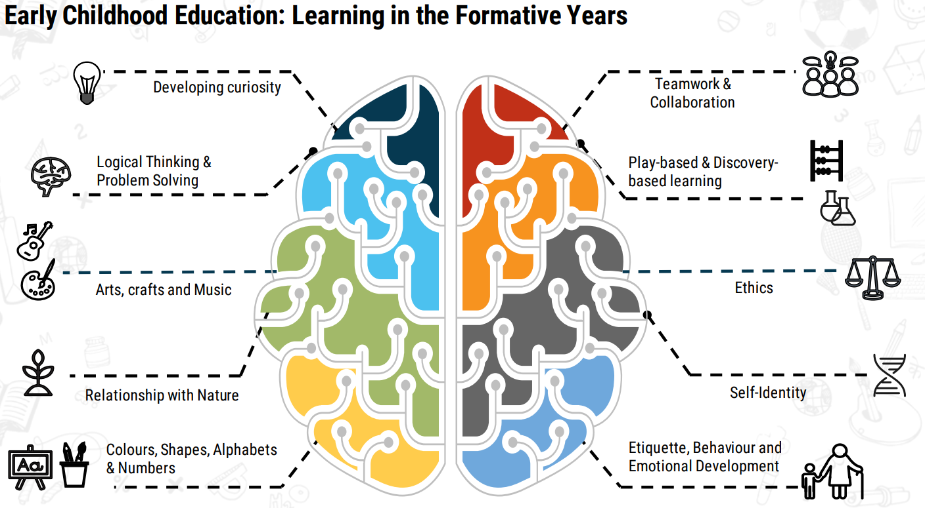

Slide 7
Curricular Goals
Physical Development
1
Language and Literacy Development
4
6
Positive Learning Habits
5
2
3
Aesthetic and Cultural Development
Social-Emotional & Ethical Development
Cognitive Development
This NCF comprises 13 Curricular Goals for Foundational Stage divided in 6 Domains mentioned above

Slide 8
Approach to Language Education and Literacy
Reading and Writing in child’s home language
Medium of Instruction in child's home language
The concept of reading and writing is initially developed through the home language whenever possible.
4
Since children learn concepts most rapidly and deeply in their home language, the primary medium of instruction would optimally be the child’s home language/ mother tongue/familiar language in the Foundational Stage.
3
Becoming Independent Reader and Writer
2
Once the concept of reading and writing is developed in a child in home language, use of additional scripts can be gradually introduced. The aim is to be an independent reader and writer by age 8 (Grade 3).
1
Exposed to multiple oral languages
Children should be exposed to and immersed in multiple oral languages from an early age. Schools will aim to ensure the presence of Teachers, and parents so that at least two or preferably three languages present with children on a regular basis.

Slide 9
Approach to Numeracy
Adoption of various approaches to teach mathematics to students in a playful way:
Developing mathematical abstract ideas (concepts) through concrete experience ENGLISH LANGUAGE PROFICIENCY STANDARD (ELPS)
Connecting mathematics learning with children’s real-life and prior knowledge
Mathematics as a problem-solving tool
Using Mathematical talk, communication, and reasoning
Developing a positive attitude towards learning mathematics
Areas of Mathematics Learning in the Early Years
Number and its Relations
Basic Mathematical Operations
Shapes and Spatial Understanding
Patterns
Measurement
Data Handling

Slide 10
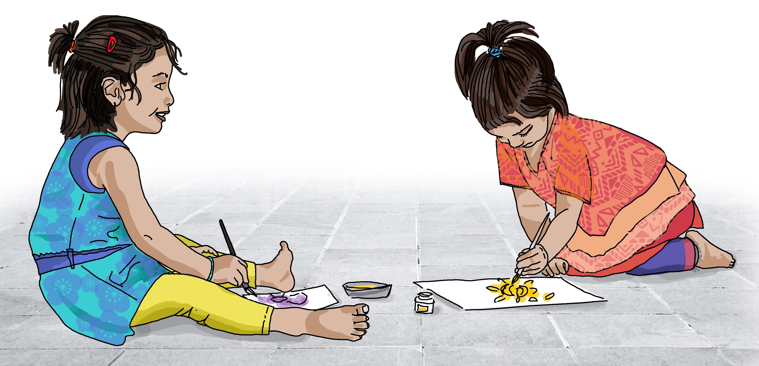
Organizing Content and Learning Material
Sensorially engaging - encourages children to examine and explore using all their senses
Drawn largely from the context of the child
Cater to different needs and levels of children
Emphasis on local material, made by Teachers and children
Print-rich environment with range of reading material - stories, poems, picture books
All grade 1 and 2 textbooks – language and math – will have environmental awareness integrated in them

Slide 11
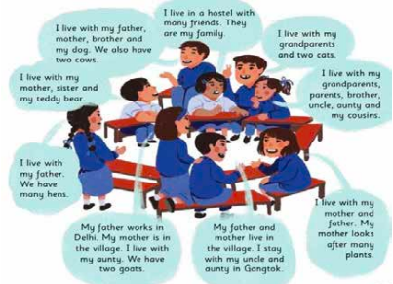
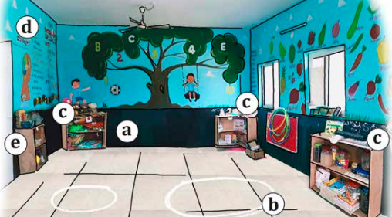
Choosing and Organising Content
TLMs and Learning Environment
Content for Language, Maths and Art
Worksheets/Workbooks
Children’s literature
Audio-Visual Material
Flashcards
Ways of Organising Content
Project-based Approach
Story-based Approach
Theme-based Approach
Eclectic Approaches

Slide 12
Assessment for Furthering Learning
Assessment Considerations for Foundational Stage
Should be a reliable source of information
Should allow for diversity in children and in their learning
Should not contribute to any additional burden for the child & teacher
Purpose
Identify the needs, preferences, and interests of the child to identify developmental challenges or learning difficulties the child might be facing
Give the Teacher an insight into the learning achievement of the child
Methods & Tools of Assessment
ELICITING EVIDENCES OF CHILD LEARNING
ANALISING & INTERPRETITING THE EVIDENCES
ACTING UPON THE EVIDENCES
Documenting & Communicating Assessments
Method 1:Systematic observation for assessment
Suggested Tools: Teachers can use tools such as anecdotal records, checklists, and event sampling to record their observation
Method 2: Analysing artefacts
Suggested Tools: Compilation of artwork and activity sheets, collection of artefacts from field trips
Teacher Narrative Summary: Anecdotal records, event samples, checklists, portfolios, worksheets
Holistic Progress Cards: Assessments done by the Teacher,observations by parents & self-assessments by children
Flow for analysing a child’s response/ responses

Slide 13
Pedagogy
Children enjoy learning through several ways -
talking, listening, using toys, painting and drawing, singing, dancing, running and jumping
Children blossom when there is a Positive relationships between Teacher, Family, and Communities
Four Block approach of teaching for
Literacy Instruction and Mathematics
Important Considerations for planning:
Panchaadi, a five-step learning process, Differentiated Instruction, Scaffolding and Gradual Release of Responsibility
Creating classroom norms with children around Self- Discipline and Classroom behaviour
PLANNING FOR TEACHING
BUILDING POSITIVE RELATIONSHIP
LEARNING THROUGH PLAY
STRATEGY FOR LITERACY & NUMERACY
CREATING POSITIVE CLASSROOM CULTURE

Slide 14
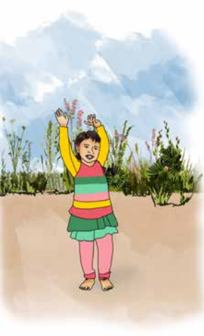
Play
Environment
Interaction
Pedagogy
Leading to make children Active and Engaged Learners

Slide 15
 | Free Play | Guided Play | Structured Play
Roles | Child – led Child directed | Child –led Teachers supported | Teacher –led Children actively Participate
What do Children do? | Children decide all aspects of their play –what to play, how to play it, for how long to play, with whom to play. | Children plan and lead their own play, similarly as they do during free play. | Children actively listen, follow rules, participate in activities and games planned by Teachers.

Slide 16
 | Free Play | Guided Play | Structured Play
What do Teachers do? | Teachers organize a stimulating play environment in classroom, observe children, and help when children ask for support. | Teachers offer support and actively facilitate play. Teachers guide the children in different tasks that they are involved in, ask questions, play with the children to meet specific learning objectives. | Teachers carefully plan activities and games with specific rules to promote competencies in a learning sequence. Language and mathematics games, nature walks, songs and rhymes are planned on a daily basis.

Slide 17
Sr. No. | Type of Play | Examples
1. | Dramatic Play / Fantasy Play | Use a small stick for a horse to dramatize a story. Acting like family members, Teachers, Doctors. Dramatizing a favourite character, e.g., Jhansi ki Rani, Rani Chennamma, Chota Bheem, Shaktimaan.
2. | Exploratory Play | Jodo, Todo, Phir Jodo – dismantling and assembling objects (e.g. clock, toilet flush, tricycle) Experiments with instruments (e.g., magnets, prism, magnifying glass, Mixing dals chana, rajma and sorting. Sand play, Water play.

Slide 18
Sr. No. | Type of Play | Examples
3. | Environment / Small world play | Using miniature animals, furniture, kitchen set, doctor set to recreate the real world and engage with it. Nature walk identifying trees, plants, insects, birds, animals, sounds, colours.
4. | Physical Play | Exploring the body through music, movement, dramatization, outdoor play balancing, games.
5. | Games with Rules | Hopscotch (Kith Kith, Stapu, Langdi), Tag, Snakes and Ladders, Chaupad, Spinning tops (Lattu, Buguri), Marbles(Goli), Kokla Chapaki, Pitthu, Pallanguzhi.

Slide 19
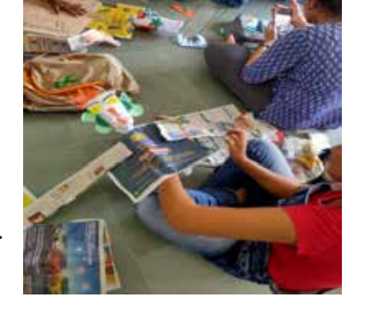
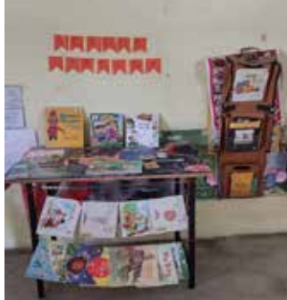
Organizing Time
To prepare organised activities that are play-based but guided and structured
.
Purpose
Supporting language development as well as socio-emotional and ethical development
Illustrative Daily Routine for Ages 3-6
Illustrative Daily/Weekly Routine for Ages 6-8
Annual School Calendar
Independent Activities for children: Circle Time, Story Time, Concept Time/Pre-numeracy are Teacher-guided and Free Play
For a small group : Learning using materials & Allowing children to choose their activity
More structured and dedicated time for literacy, numeracy and arts
Informative and accessible annual plan calendar detailing all important events to be shared
Activities for ages 6-8
Sample calendar
Sample outine

Slide 21
Additional Critical Areas
1
Early identification of children who are ‘at risk’ for developmental delays and disabilities is very crucial for timely intervention
2
Ensuring physical and emotional safety of children in schools and providing a secure environment
Role of Foundational Stage Institutions
Role of Teachers
Adult supervision must always be present
No physical violence or corporal punishment with children
Adults must not bully, harass, or intimidate children even by implication or covertly.
Teachers must intervene inappropriate behaviour
Zero tolerance of child sexual abuse.
Teachers and all other adults must be aware of child sexual abuse, and the POCSO Act
Learn as much as possible about the child.
Setting goals for the child that are realistic and achievable.
Make information as concrete as possible.
Using a multi sensory approach.
Sensitize other children to the situation
Observe the child to understand the child’s functioning
Record daily or weekly observation
Share concern with parents and family.
Refer the child to an appropriate medical professional
focussed work with the child in school..

Slide 22
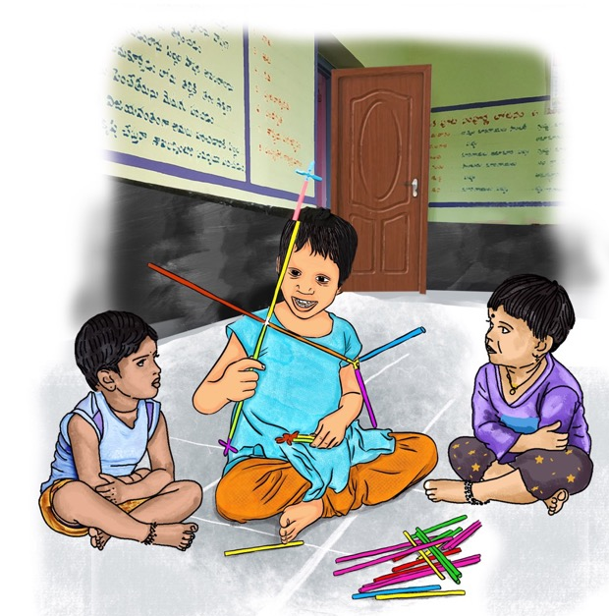
Connections to the Preparatory Stage
1
3
Gradual shift from Development Domains to Curricular Areas (subjects) in the Preparatory Stage
Begin to move from concrete, sensorial experiences to more abstract ideas, concepts
4
Assessment through some formal tasks in addition to structured observation - continues to be an integral part of classroom process
2
Gentle move from child-led pedagogical exploration to a more formal learning environment
5+3+3+4 Curricular and Pedagogical design necessitates continuity and change across Stages

Slide 23
Creating a Supportive Ecosystem
Ensuring an Appropriate Environment for Learning
Role of Academic and Administrative Functionaries
Role of Parents and Community
Ensure joyful and adequate learning infrastructure/resources
Suitable Pupil Teacher Ratio and appropriate age of admission
Principals contribute to shaping supportive and empowering culture
Cluster/Block level functionaries provide critical feedback for improvement/development
Ensure presence of adequate teachers, TLM, access for SEDGs etc
Parents/family as co-partners with schools to aid child learning and development
Community can support in ensuring enrolment, attendance, observations etc
Enabling and Empowering Teachers
Leveraging Technology
Requires a conducive teaching environment, culture, and facilities
Teachers must be equipped through adequate training, mentoring
Teachers are provided career progression and autonomy with accountability
Technology can support in accelerating capacity building, enabling participation and engagement, and synergies among stakeholders
Use cases: QR code textbooks, translation, disability screening etc
03
02
04
01
05

Slide 25
Recent Initiatives Taken By education ministry

Slide 26
Add a Slide Title - 1

Slide 27
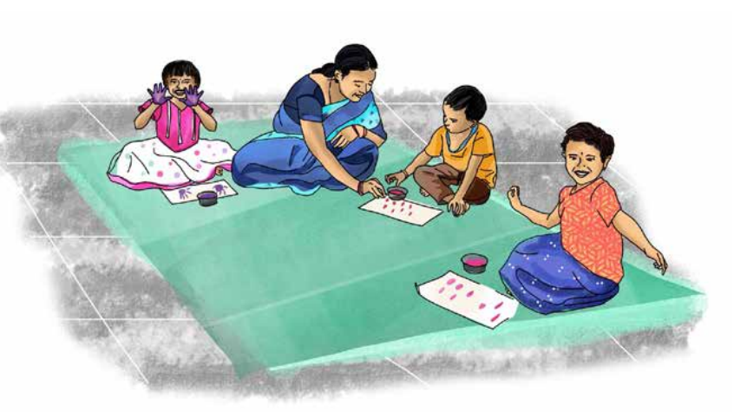
In NIPUN BHARAT guidelines for foundational literacy and numeracy mission, the competencies for holistic development of the child from 3 to 9 years are codified under three developmental goals.

Slide 28
Development Goal 1
Children maintain good health and well-being
To provide experiences for physical and motor development, socio-emotional development, nutrition, safety, hygiene and sanitation
Development Goal 2
Children become effective communicators
To build the foundations for language and literacy
Development Goal 3
Children become involved learners and connect with their immediate environment
To build foundations of numeracy, and provide direct experience and interaction with the physical, social and natural environment

Slide 29
DG
Developmental Goal 1
Gross Motor Skills Fine Motor Skills
Eye hand coordination
Socio - Emotional development
Health & Nutrition Hygiene
Safety
Developmental Goal 2
Talking &listening Reading with Comprehension
Writing with purpose
Developmental Goal 3
Sensory Development , Cognitive Skills
Concepts related to Environment, Number Sense

Slide 30
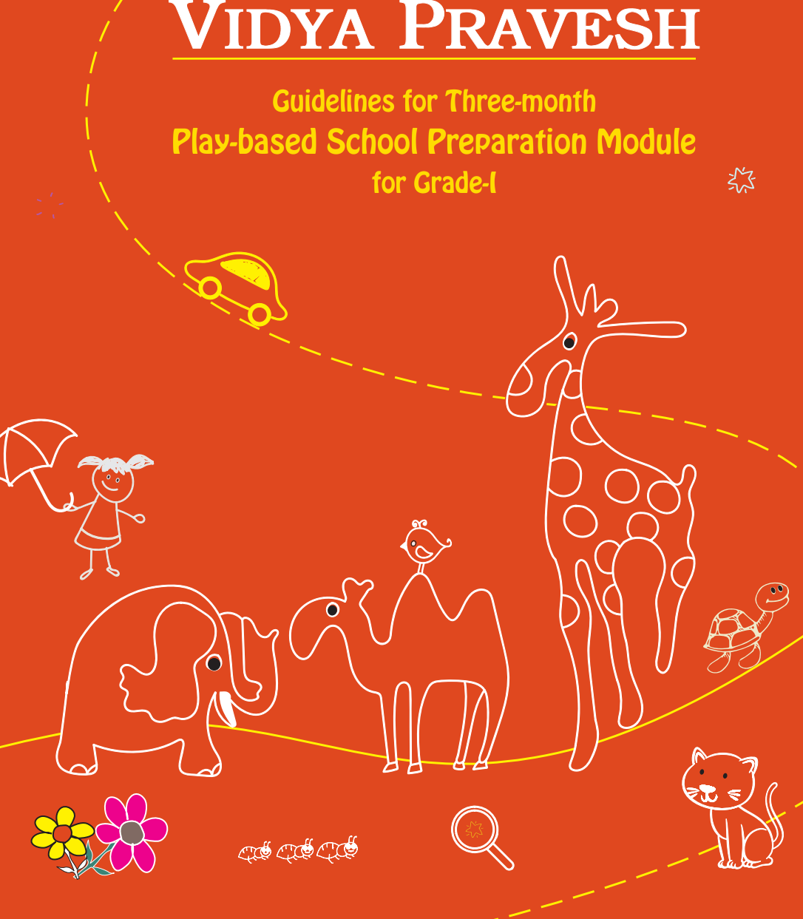
VIDYA pravesh—guidelines for three-month play-based school preparation module for grade-i children, has been developed as per the recommendations of the national education policy (NEP) 2020.
The document suggests three months or 12 weeks preparation as an interim measure until the universal provisioning of quality early childhood development, care and education is achieved with a target to ensure that all children entering grade-i are school ready at least by 2030 (nep 2020). VIDYA PRAVESH is an integral part of NIPUN BHARAT—A national mission on foundational literacy and numeracy (FLN mission) of the government of india and well aligned to the key competencies and the learning outcomes of preschool 3 (balvatika)

Slide 31
School
Provision of stimulating safe , secure and joyful learning environment , play based pedagogy
Opportunities for experimentation ,exploration , problem solving, critical thinking and interaction, Focus on the development of foundational literacy and numeracy competencies
Family
Warm, caring, supportive and joyful learning environment at home, Appreciate and encourage children’s learning
Engage with children, talk and play with them, support children’s overall well being
Children
Learn joyfully, maintain good health and well being , become effective communicators
Become involved learners and connect with their immediate environment

