Slide 1
EDUCATION IS NOT THE LEARNING OF FACTS BUT THE TRAINING OF THE MIND TO THINK
Education exposes children to new ideas and helps them to make a path to a career. The goal of children education is to develops skills, the spirit of competition and enhances personality development.

Slide 2
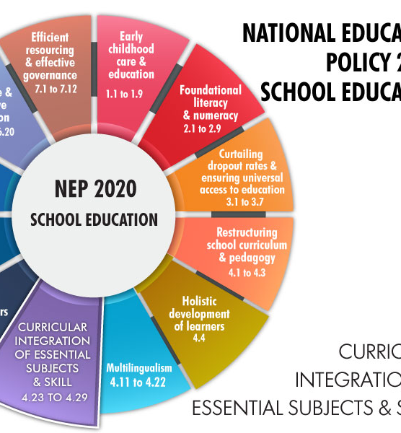
INTEGRATION OF VOCATIONAL AND SKILL-BASED TRAINING INTO THE EDUCATION SYSTEM
PRESENTATION BY :
BABITA SHARMA ( SCIENCE FACULTY , BPS PILANI)

Slide 3
Vocational education in NEP
by 2025,
Vocational exposure through school and higher education.
Every child is supposed to learn at least one vocation and be exposed to several more.

Slide 4
EMPHASIS ON NON-ACADEMIC SUBJECTS
The NEP emphasizes the
Importance of teaching a wider range of subjects
Arts, sports, and vocational skills, in addition to traditional academic subjects.
To provide a more flexible and diverse range of educational pathways.

Slide 5
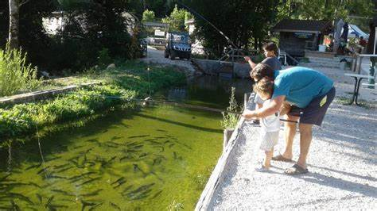
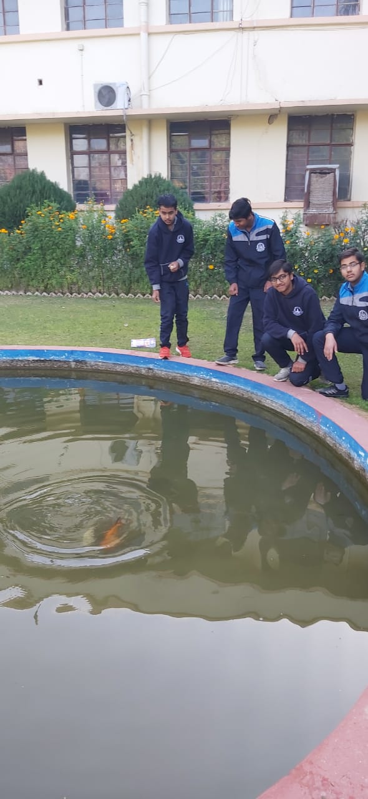
BIO LAKE

Slide 6
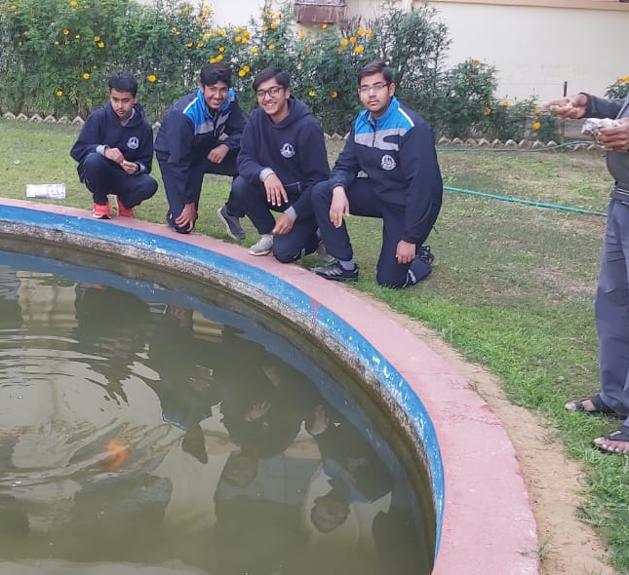
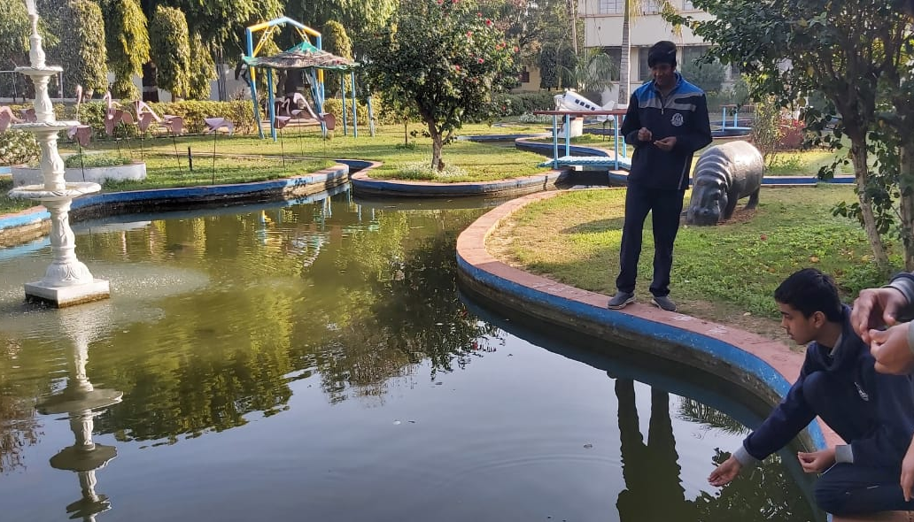
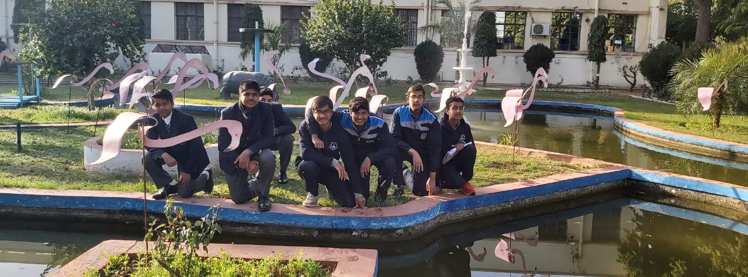

Slide 8
Birla Public School,Pilani Annual Curriculum Plan for the session 2022-23
Months | Lessons /Topics Covered | Learning Objectives Students will be able to: | Suggested Activities | Assessments | Expected Learning Outcomes Students are able to:
April | LIFE PROCESSES (a) Autotrophic nutrition (b) Heterotrophic nutrition Nutrition in human beings | -develop the concept of life processes - explain the steps in the process of photosynthesis - compare and contrast the steps of opening and closing of stomata - identify the type of heterotrophic nutrition in living organisms on the basis of their features -arrange/sequentially all the steps of digestion of food in human - to draw labelled diagram of human digestive system | Experiment: Preparing a temporary mount of a leaf peel to show stomata. To draw well labeled diagram of human alimentary canal on a piece of chart paper | MCQs Pen and paper test | - arrive at the meaning of autotrophic nutrition (photosynthesis) - compare and contrast the steps of opening and closing of stomata - investigate the impact of environment on opening and closing of stomata - identify the type of heterotrophic nutrition in living organisms on the basis of their features - develop the definition of digestion - evolve the meaning & function of enzyme - arrange/sequentially all the steps of digestion of food in human - draw labelled diagram of human digestive system

Slide 9
Formation of NCIVE
MHRD will constitute National committee for integration of vocational education consisting of experts in vocational education

Slide 10
SKILL BASED LEARNING
The teaching of vocational courses from class 6
In the form of internships and practical activities
every student should at least study one vocational course.

Slide 11
Skills
Scientific temper
Evidence based thinking
Creativity and innovativeness
Sense of aesthetics and art
Oral and written communication
environmental awareness
sanitation and hygiene
Physical education
Fitness
Wellness
Collaboration and teamwork
problem solving and logical reasoning

Slide 12
BAGLESS DAYS
There will be ‘no hard separation’ between the ‘vocational and academic streams.
School students will have
10 bagless days in a year,
exposure to a vocation of choice.
Supplemented by experiential vocational learning from Grades 6 to 8.
Every student will take a fun course that gives a survey and hands on experience of vocational crafts

Slide 13
INTERNSHIP PROGRAMME
10 DAYS PROGRAMME BY VINOBA
SUMMER AND WINTER VACATION

Slide 14
GREEN HOUSE ACTIVITY
MEDICINAL PLANTS
NUTRI GARDEN

Slide 15
CARPENTRY

Slide 16
SCHOOL ACTIVITIES

