Slide 1
Entrepreneurship Education and NEP 2020
A Journey towards Atmanirbhar Bharat Abhiyan

Slide 2
The National Education Policy 2020 has a big focus on innovation as a tool for revamping the educational system.
The need for quality improvement in the curriculum and the desire to equip students.
with 21st century competency skills has brought innovation at the core of the educational ecosystem.
Hence, school culture that support innovation should be developed and encouraged extensively.
CBSE along with the Ministry of Education’s Innovation Cell has developed guidelines for schools for promotion of Innovation and Entrepreneurial skills in students.
Titled ‘National Innovation and Entrepreneurship Promotion Policy (NIEPP)’.

Slide 3
The world is undergoing rapid changes in knowledge landscape.
With various dramatic scientific and technological advances, the kind of jobs that will become mainstream in future is difficult to predict.
young students will need key skills like creativity, innovation, empathy, problem solving, team work, strategic thinking, entrepreneurship as well as learning to accept failures as a part of their development process.
we have to instill a culture of innovation and entrepreneurship in our education system beginning from the school level itself.
An innovation and entrepreneurship focused education will play a central role in developing crucial life skills and prepare students for a life beyond classrooms.

Slide 4
As per NEP 2020 Part IV ( Making It Happen ) Chapter 26 : Financing : Affordable and Quality education for all-
NEP 2020 has strongly recommended that Government ( Both Center and State ) must invest 6% of GDP on Education

Slide 5
Government spending on Education

Slide 6
India has become 5th largest economy in the world
India's GDP is currently $3.6
trillion ( 3% of GDP Spend on Education)
India's GDP $5.0 trillion by 2025 (Recommended 6% of GDP spend on Education)

Slide 7
Large amount spend on education = create more educated people in future
More Educated People required Job Employment
What is the Solution ?
Ans: To create More Entrepreneur

Slide 8
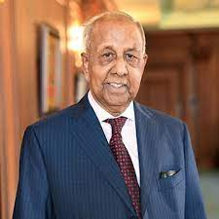
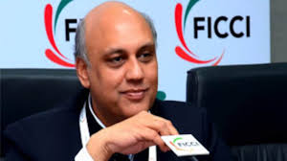
ALL TIME GREAT ENTREPRENEUR G D Birla Syt. S K Birla Syt. Sidhart Birla

Slide 9
Country Needs Many Entrepreneurs
Like : G D Birla
Ratan Tata
Mukesh Ambani
Azim Premji
Gautam Adani
Shiv Nadar
Kumar Mangalam Birla
Sunil Mittal
And Many More…………………………….;

Slide 10
Action Points ( Specific Measures ) to develop Entrepreneurial skill among students
Middle Stage – Grade 6th To 8Th
Mindset Change
Piggy Bank
Minimum 2 hours in a week for Tinkering
Meeting with Entrepreneur
Hands on Experience
Bag less Day
Field Visit
Financial Literacy Program
Internship
Celebration of National Innovation and National Entrepreneur Day
Fun activities and Innovation Club
Students enrichment program
Socio- economic innovation challenge program
Business Quiz/ SHARK TANK

Slide 11
Mindset Change
Parents
Students
Teacher
Society

Slide 12
Piggy Bank
To Develop saving habit among the children from the early childhood

Slide 13
Minimum 2 hours in a week for Tinkering
Tinkering has recently been introduced into the educational field as a potential driver of creativity, excitement, and innovation in learning

Slide 14
Meeting with Entrepreneur
Name any hostel /Academic block on the name of any entrepreneur

Slide 15
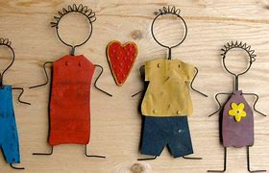
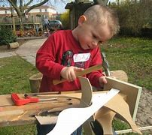
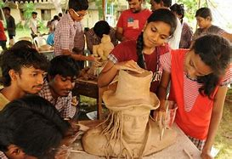
Hands on Experience
Metal Craft
Wood Craft
Clay Modelling
Gardening

Slide 16
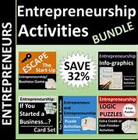
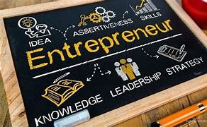
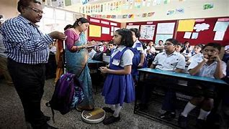
Bagless Day

Slide 17
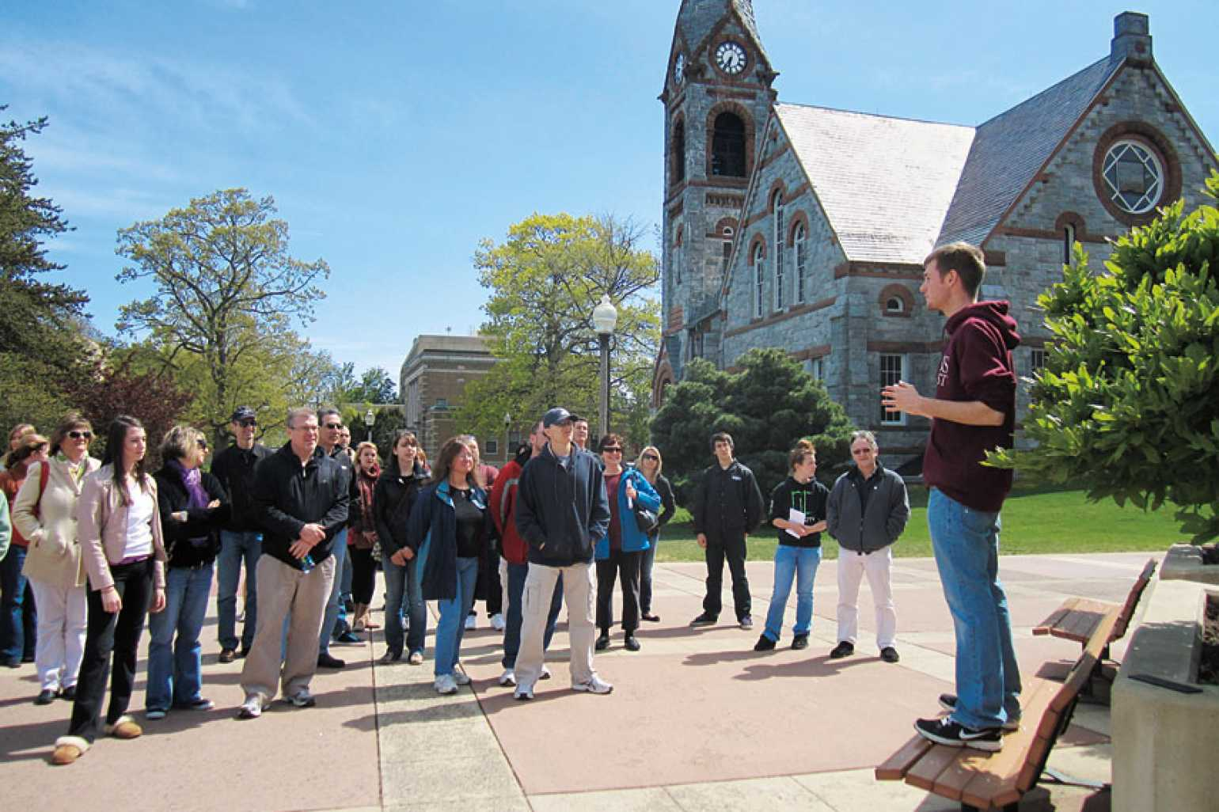
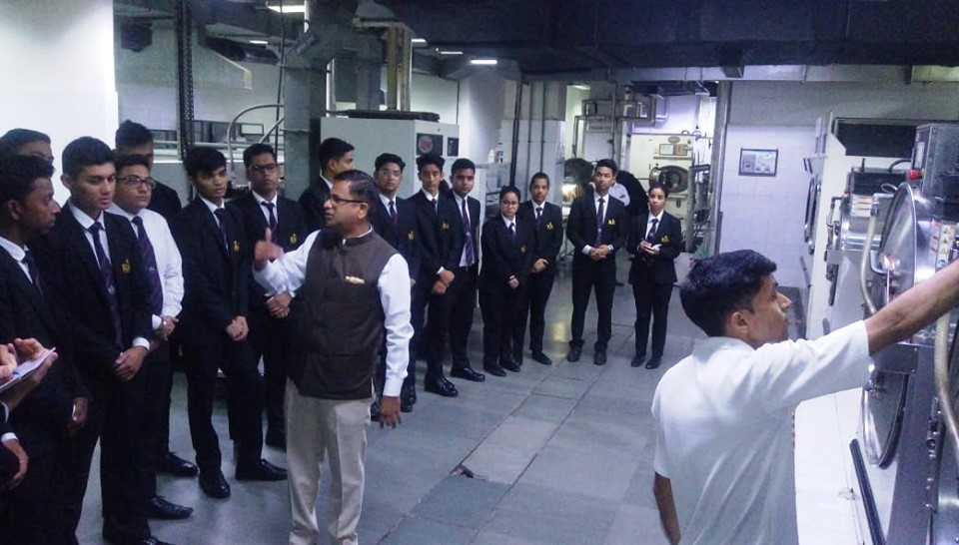
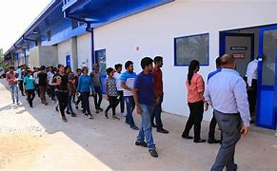
Field Visit & Financial Literacy Program
1.Picnic
2.Tour and Trekking
3.Preparing canteen and mess budget

Slide 18
Internship
BPS have already planed students internship program with VINOBA (Old Boys Association)on summer and winter vacation

Slide 19
SHARK TANK
To Conduct Business Quiz

