Slide 1
NEP 2020
Challenges & Opportunities
in Implementation
Presented By:
Mr. Rajesh Kumar
TGT Maths
Birla School, Pilani
Feb25,2023

Slide 2
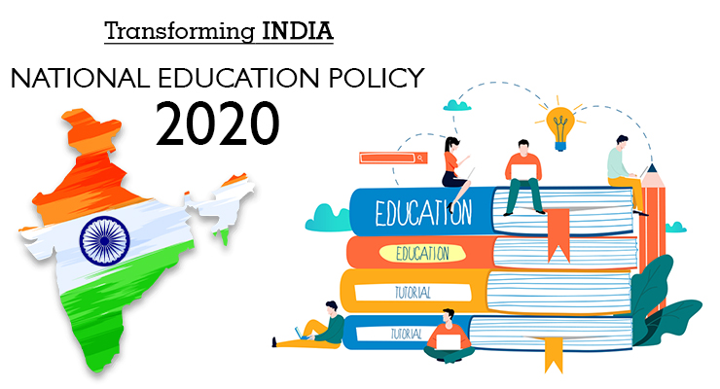

Slide 3
NEP 2020
The policy is aligned with
The 2030 Agenda for Sustainable Development
Focus on remoulding India into a global knowledge superpower
Making school education more holistic, multidisciplinary,
flexible, suited to 21st – century requirements
Aims at bringing out the individual capabilities of each student.
It believes that the goal of education is to produce good people who are capable of critical thinking and action and have compassion and empathy, courage and endurance, scientific temper and imagination and ethical moorings and values

Slide 4
ACCESS
AFFORDABILITY
FIVE PILLARS OF NEP 2020
QUALITY
EQUITY
ACCOUNTABILITY

Slide 5
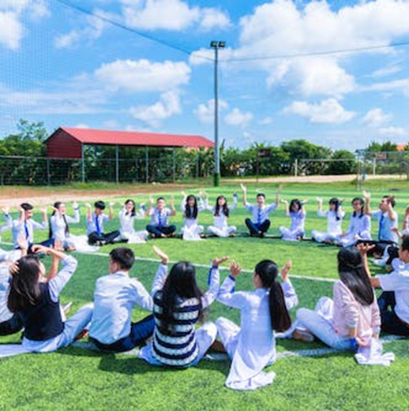
To reach everyone, to have the widest impact possible, education must be easy to access.
We must significantly lower the barrier to entry.
NEP 2020 aims at 100% Gross Enrolment Ratio (GER) in school education by 2030.

Slide 6
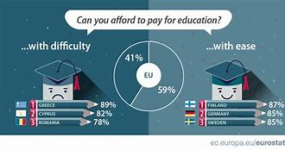
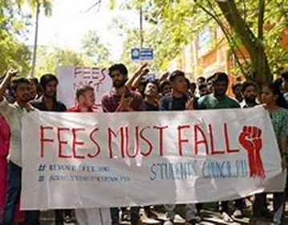
Lowers the primary barrier to pursuing education
Lowers the risk related to exploring areas of learning interest
Can increase retention rates of students
Long-term Student Success begins with Affordability

Slide 7
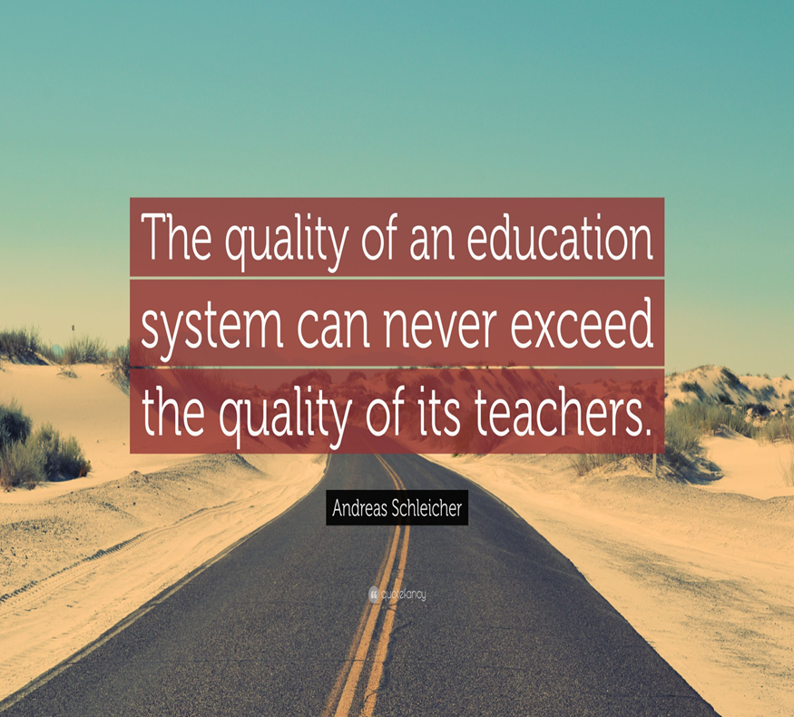
EQUALITY
SUSTAINABILITY
CONTEXTUALISATION AND RELEVANCE
BALANCED APPROACH
CHILD- FRIENDLY & CHILD- CENTRIC
LEARNING OUTCOMES

Slide 8
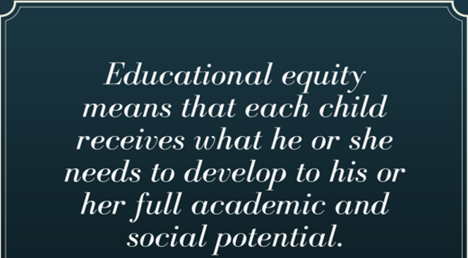
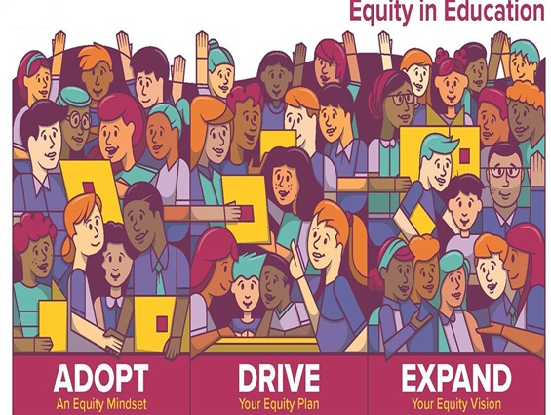

Slide 9
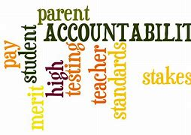

Slide 10
OPPORTUNITIES

Slide 11
NEP 2020
Opportunities
Holistic Development
Multidisciplinary Approach
Use of Technology
CPD
( Continuous Professional Development)
Integrated and Inclusive Education
Activity-based & Experiential Learning
Enquiry-based and Discovery based Learning

Slide 12
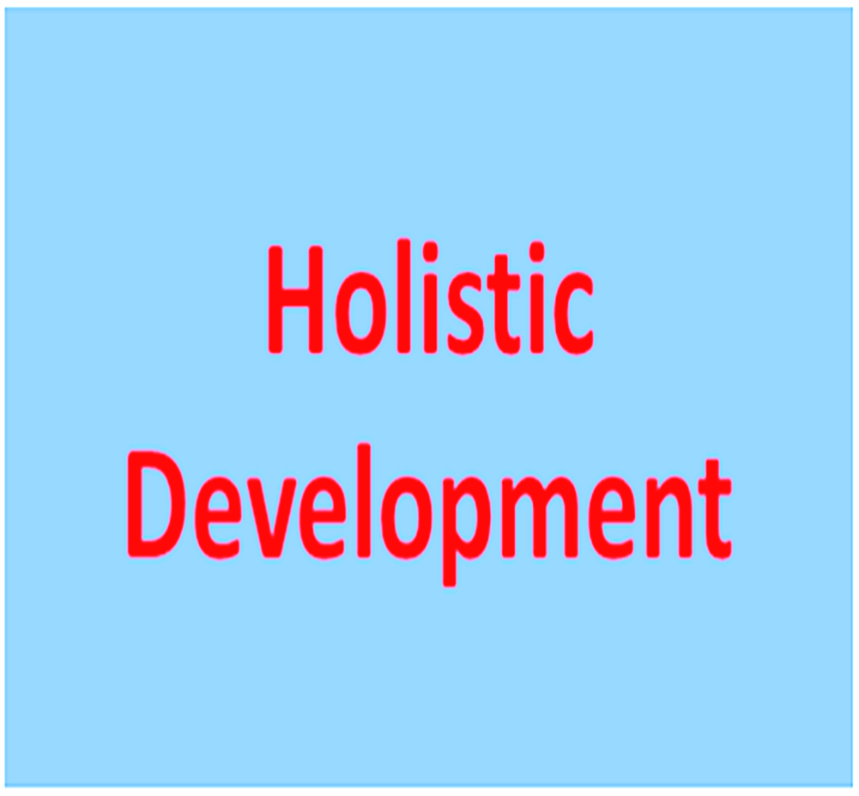
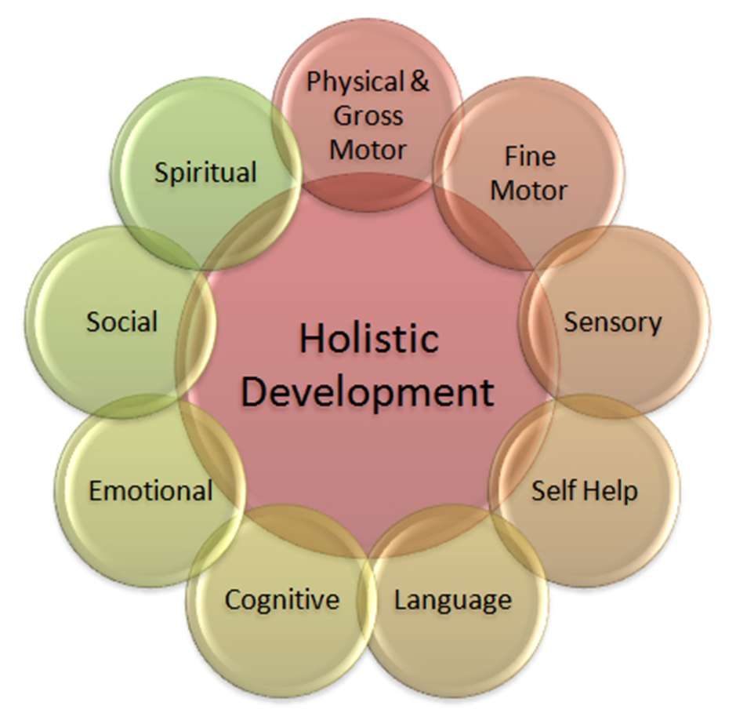
The following are the five key areas of holistic development
Physical development – all about growing and developing motor skills.
Social skills – how children interact with others and communicate in their world.
Emotional understanding – learning to express emotions in a healthy way.
Intellectual development – cognitive, creativity and acquiring skills for learning.
Spiritual development – building morals, values and caring for the world.

Slide 13
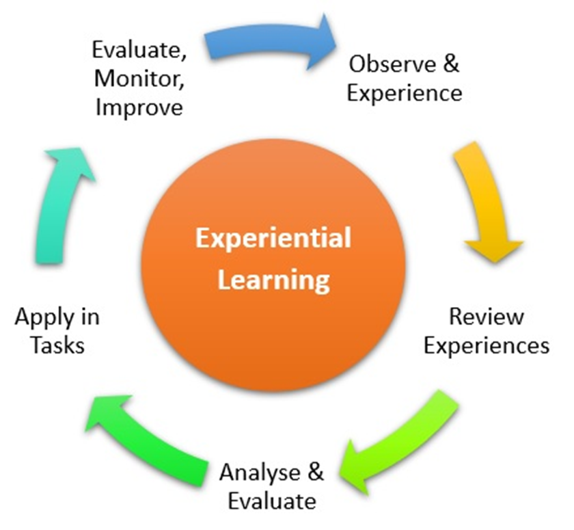

Slide 14
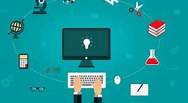
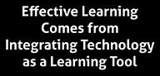
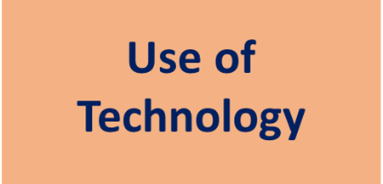

Slide 15
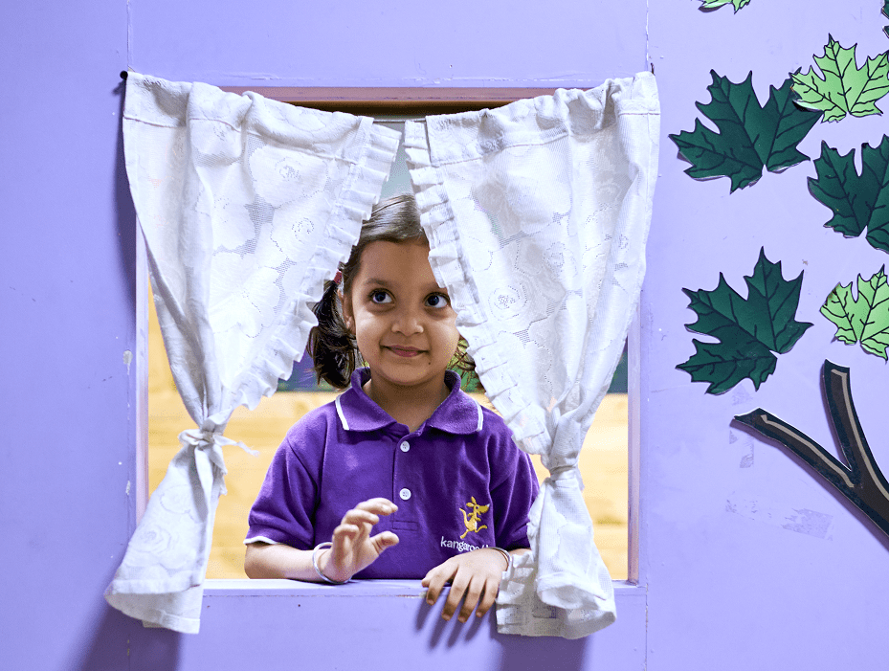
Objective of Holistic Report Card
It helps to map the status of each child's learning for foundation literacy and numeracy skills.
It focuses on the uniqueness of each learner.
To present a picture of the student’s progress and provide evidence as well as an opportunity to a child to present his or her growth in the progress review over years.
To document a child's own expression of self as well as the teacher’s assessment of the child based on the competencies.
It will form an important link between home and school and makes parents an integral part of a child’s learning process.

Slide 16
NEP 2020
Challenges
Changing The Mindset
Teachers’ Training
Infrastructure & Resources
Assessment & Evaluation
Technology
Flexibility

Slide 17
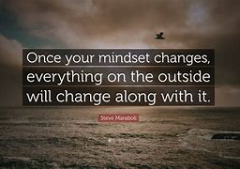
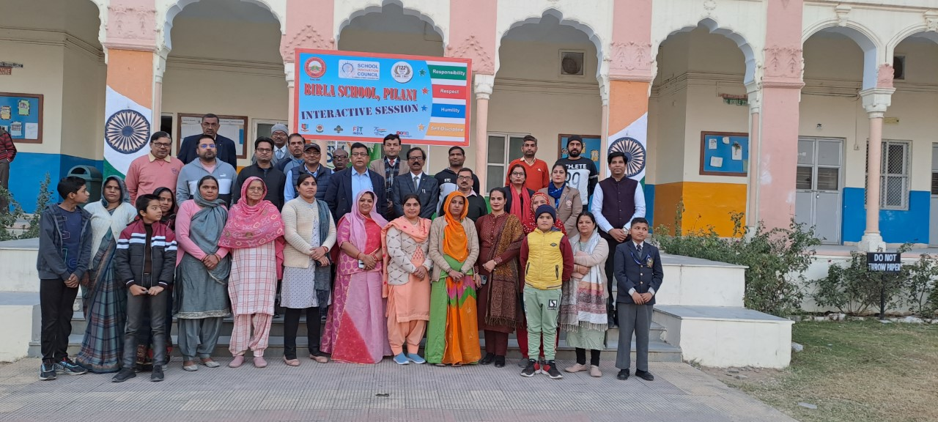
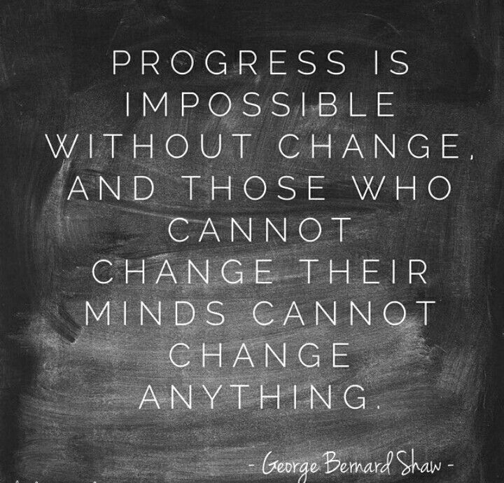
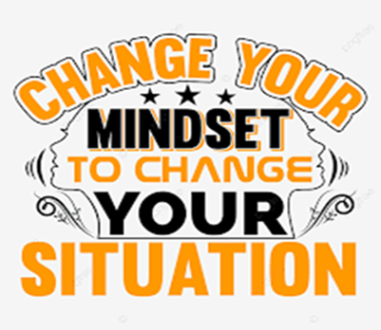

Slide 18
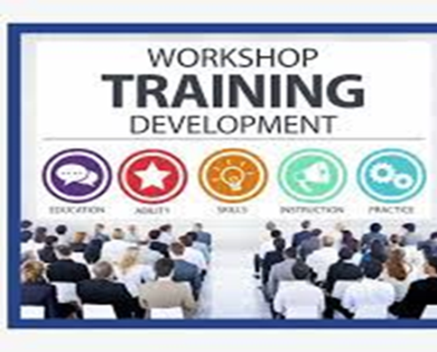
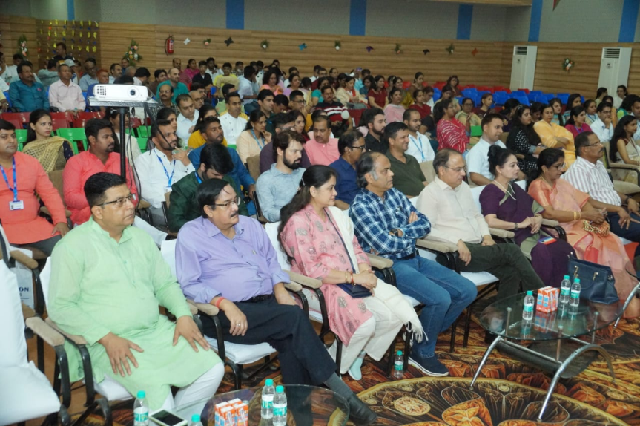

Slide 19
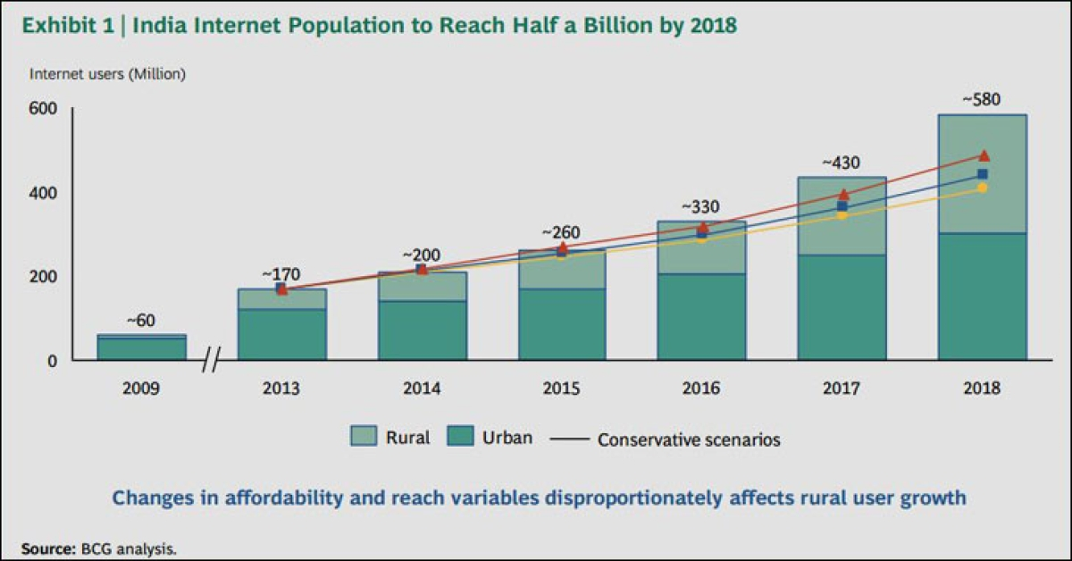
TECHNOLOGY
• Problems with electricity
• Lack of Internet connection penetration
• Internet connection plans and the speeds
• Lack of devices for digital education
• The fear of parents
• Experienced teachers and online classrooms
• The distraction of students in online education
• The unfriendly situation in homes

Slide 20
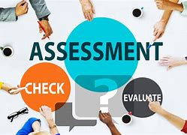
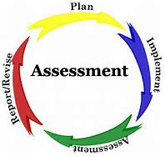
Evaluating through technology
Descriptive measures for student growth
Holistic progress card
4.Involving parents in evaluation process

Slide 21
The National Education Policy has removed barriers of subject streams (arts, science & commerce) that restricts students of one stream from choosing any particular subject from another stream.
It will be an uphill task for schools to provide the combination of subject asked by the student. It may even not be helpful in pursuing a career.

Slide 22
Schools &Teachers
Students &Parents
NEP2020

