Slide 1
Socio-Emotional and Ethical Development at Foundational Stage
Bharti Yadav
Special Educator, Birla Shishu Vihar

Slide 3
Social Emotional & Ethical Learning curriculum expands on traditional social emotional learning (SEL) frameworks.

Slide 4
Seva, Ahimsa, Swacchata, Satya, Nishkam karma, respect for women, elders, all people and the environment.

Slide 5
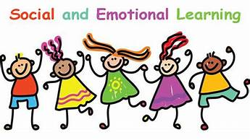
Social, emotional, and related skills, attitudes, behaviors, and values that help direct students.

Slide 6
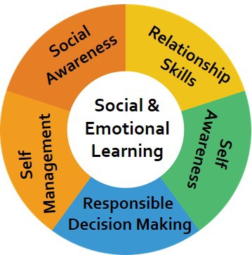
5
Components
in SEL

Slide 7
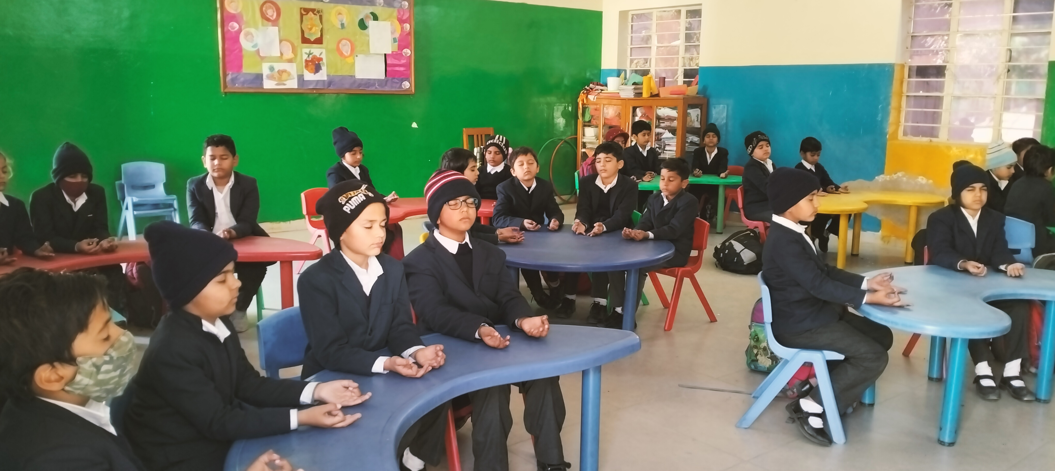
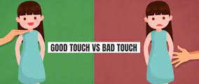
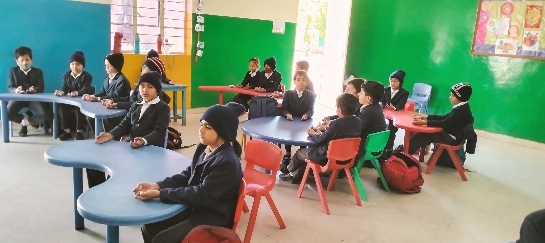
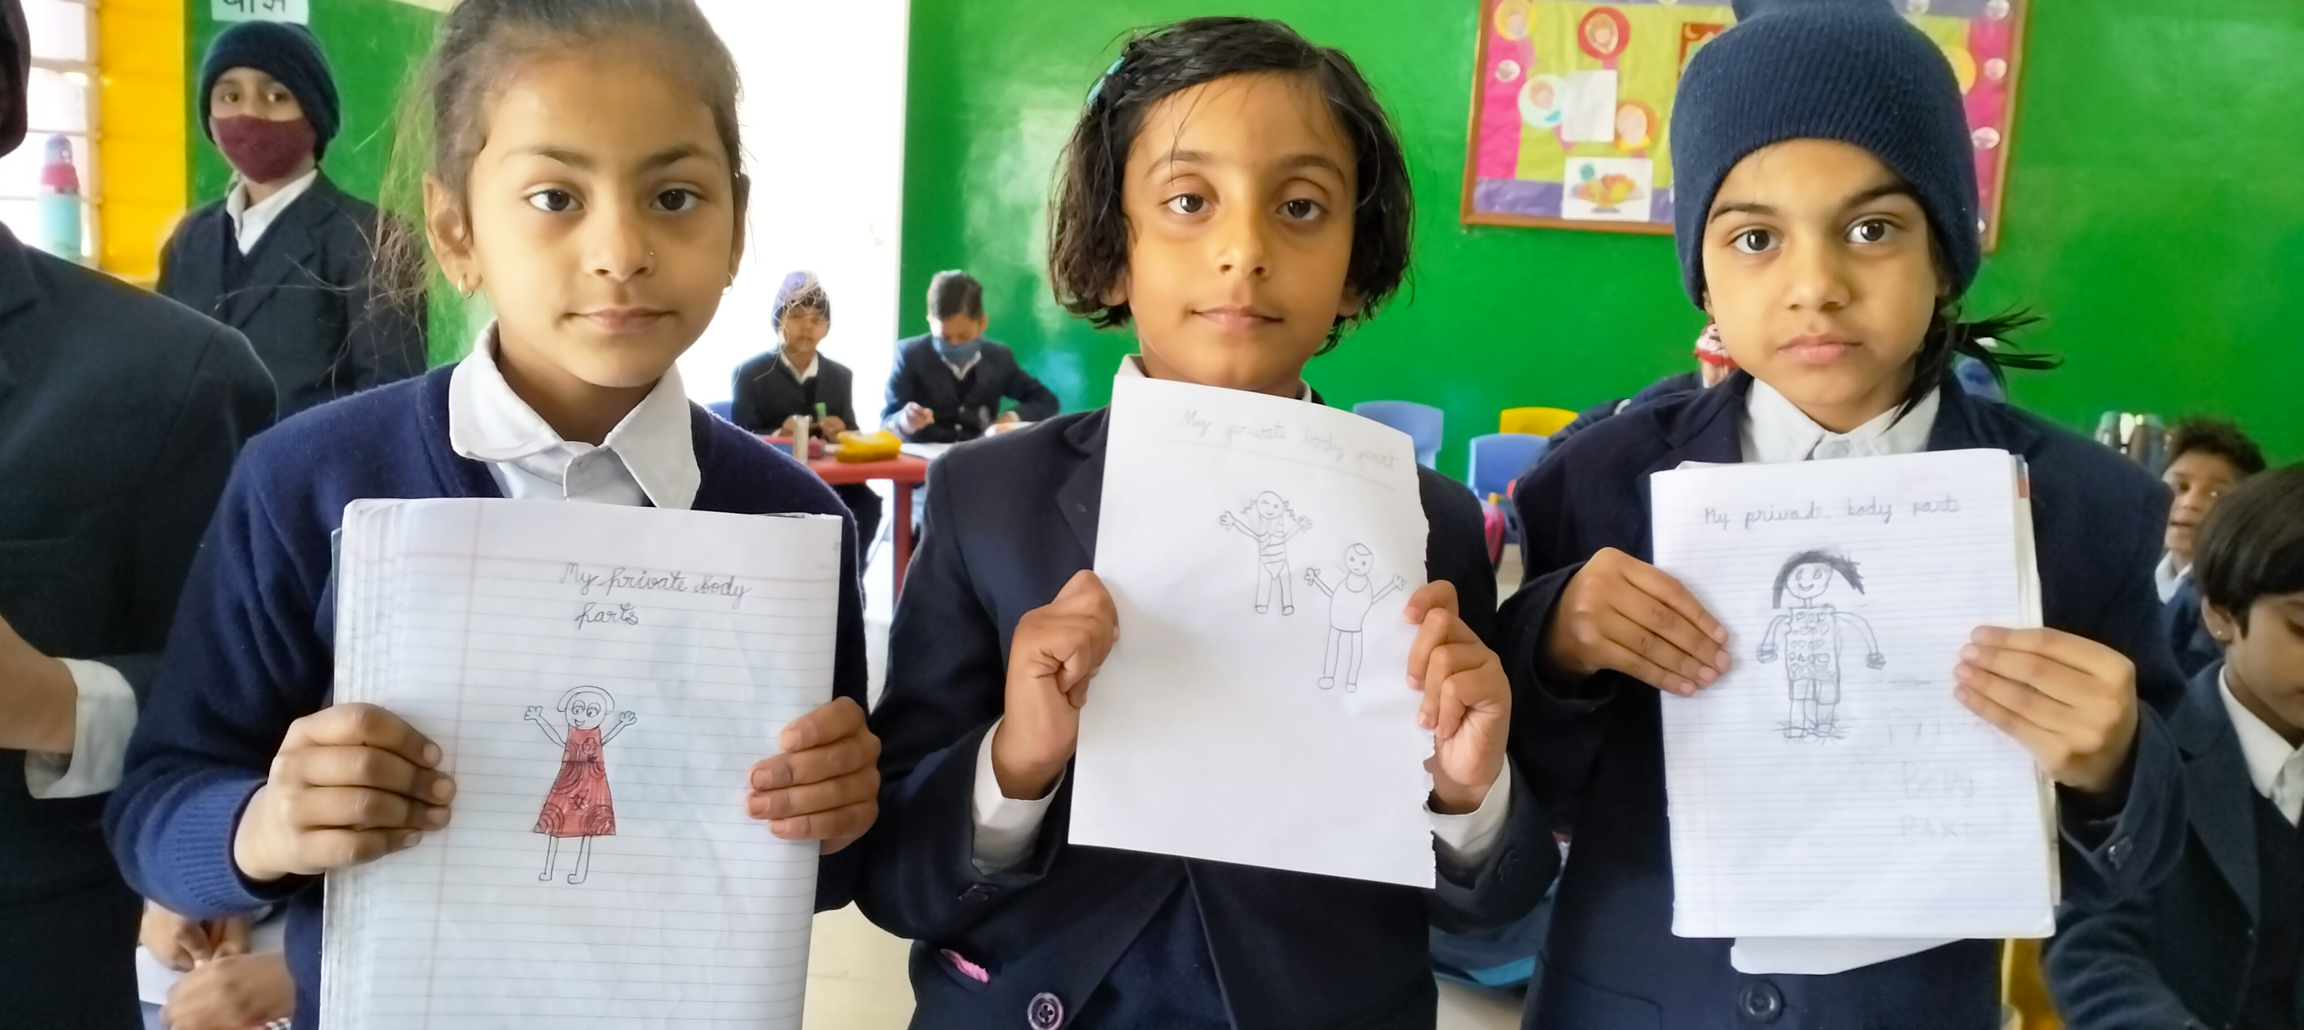
Self-Awareness
Mindfulness Meditation
My
Private
Body
Parts

Slide 8
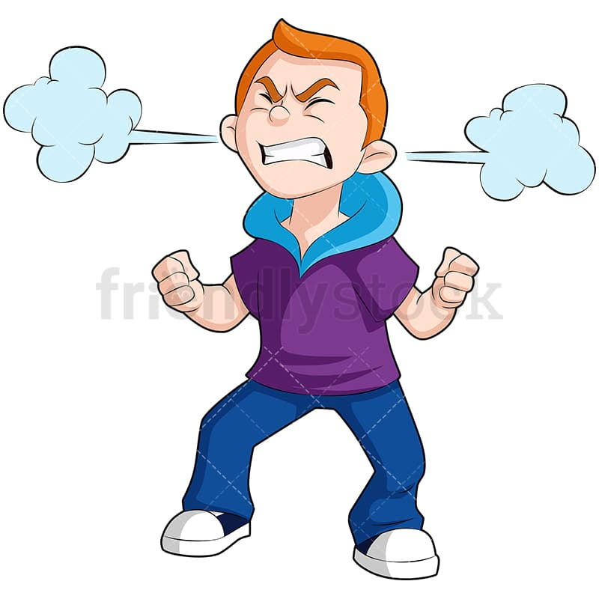
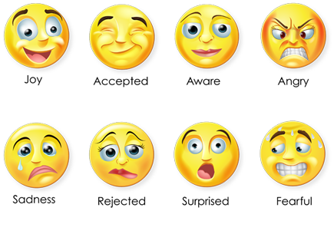
Self-management
Different types of emotions
Anger Management

Slide 9
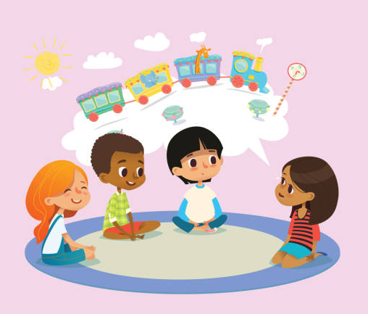
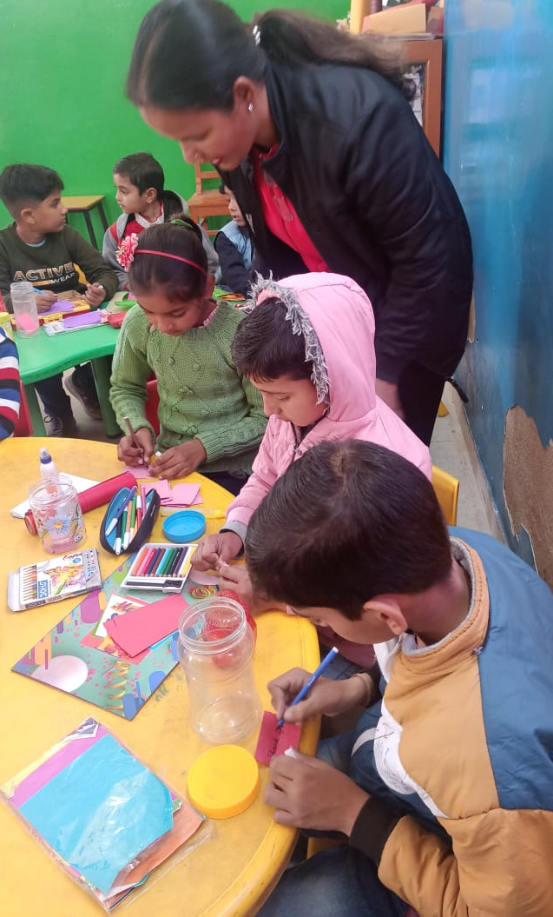
Social Awareness
Listening
To
others
My
Gratitude
Jar

Slide 10
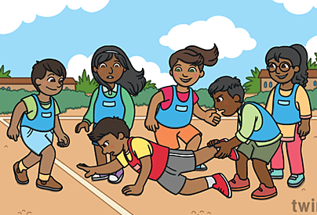
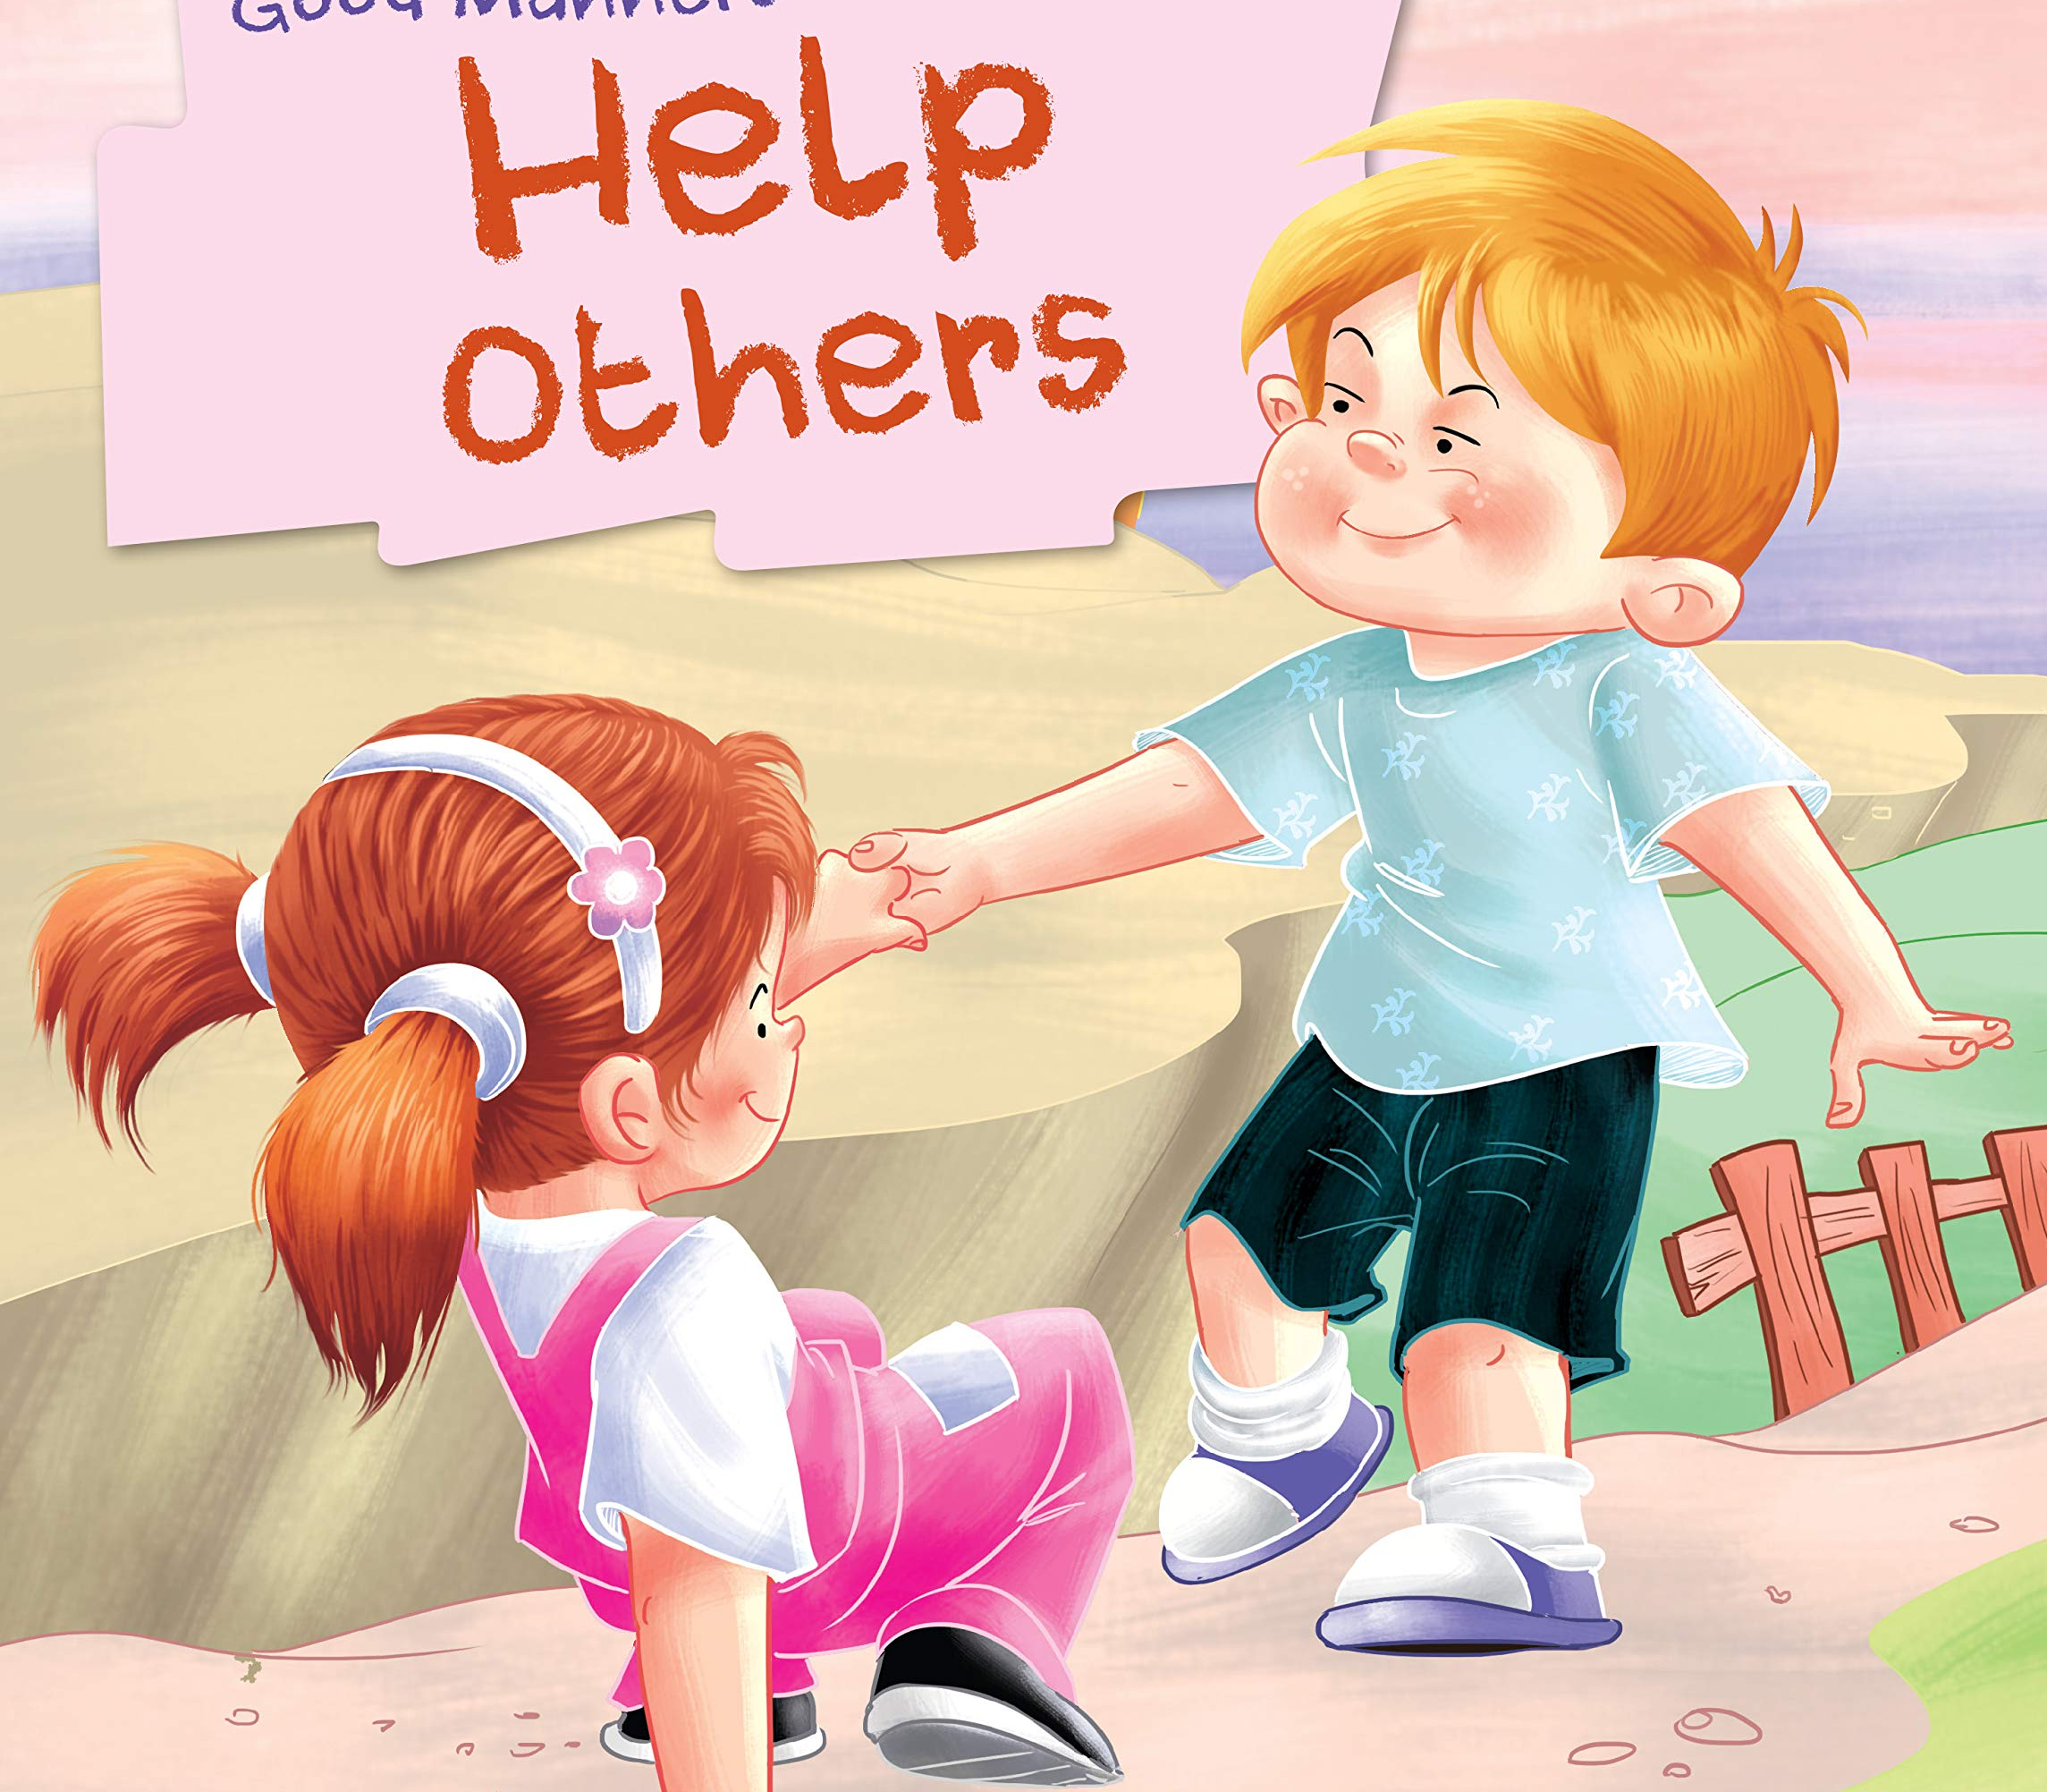
Relationship skills
Team
Games

Slide 11
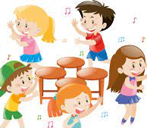
Responsible decision making
Number Game
Musical Chair

Slide 12
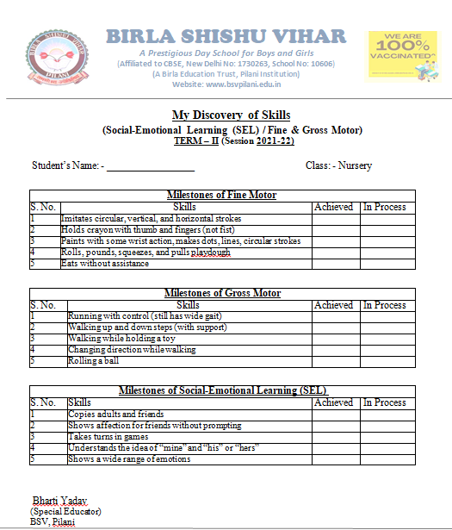
Holistic Report Card of SEL & Motor skills Milestones

Slide 13
SEL Milestones of Grade Nursery
Copies adults and friends
Shows affection for friends without prompting
Takes turns in games

Slide 14
SEL Milestones of Grade LKG
Would rather play with other children than alone
Cooperates with other children
Plays “Mom” or “Dad”

Slide 15
SEL Milestones of Grade UKG
Wants to be like friends
Is more likely to agree with rules
Expresses likes and dislikes

Slide 16
SEE LEARNING (Social Emotional & Ethical Learning) = SEL 2.O

Slide 17
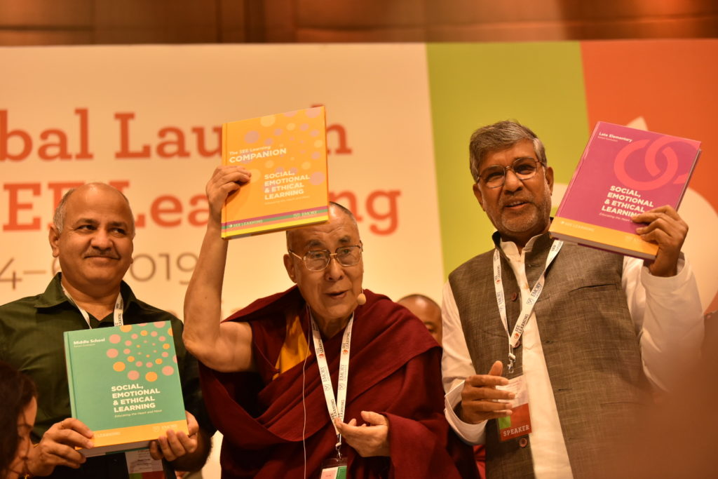
SEE LEARNING

Slide 18
SEE LEARNING (SEL 2.0)
Social, emotional, and ethical learning programs for K-12 and higher education.

Slide 19
Goals of SEE Learning?
Manage emotions, and respond positively, positive attitude and service.

Slide 20
SEE Learning 3 Dimensions 3 Domains = 9 Components

Slide 21
9 Components of SEE Learning

Slide 22
Attention and Self-Awareness
Emotions
Feelings

Slide 23
Self-Compassion
Self-acceptance

Slide 24
Self-Regulation
Impulse control
Navigate emotions

Slide 25
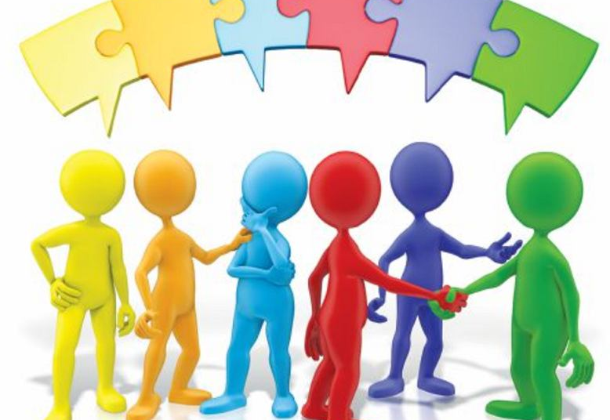
Interpersonal Awareness
Appreciating diversity & differences

Slide 26
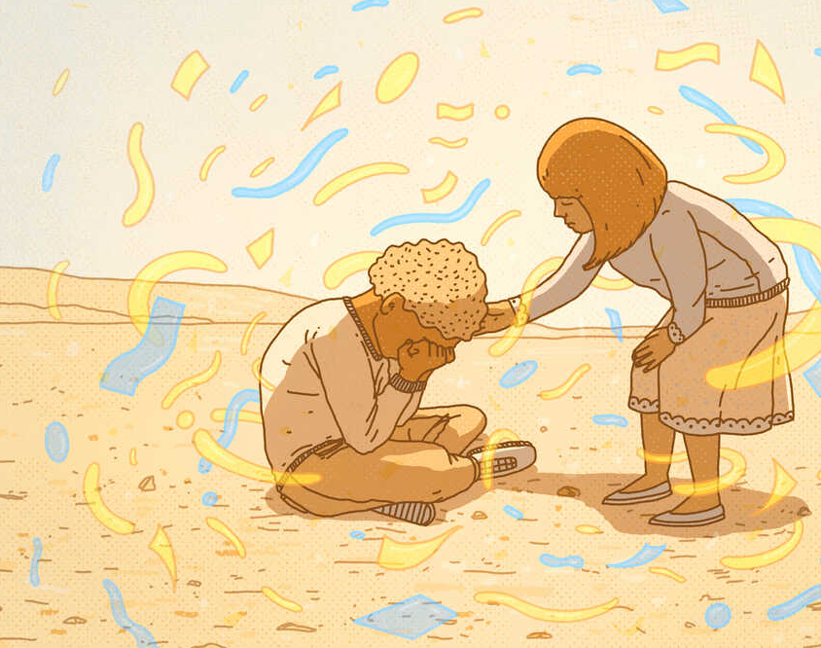
Compassion for others
Cultivating Kindness & Compassion

Slide 27
Relationship Skills
Empathic Listening & Skillful Communication

Slide 28
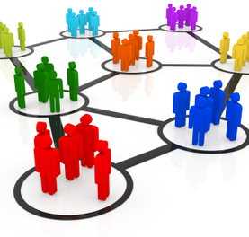
Appreciating Interdependence
Understanding
Interdependence
System

Slide 29
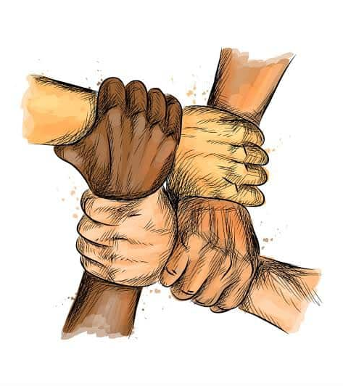
Recognizing Common Humanity
Appreciating Fundamental Equality

Slide 30
Community and Global Engagement
Potential for positive change in community

Slide 31
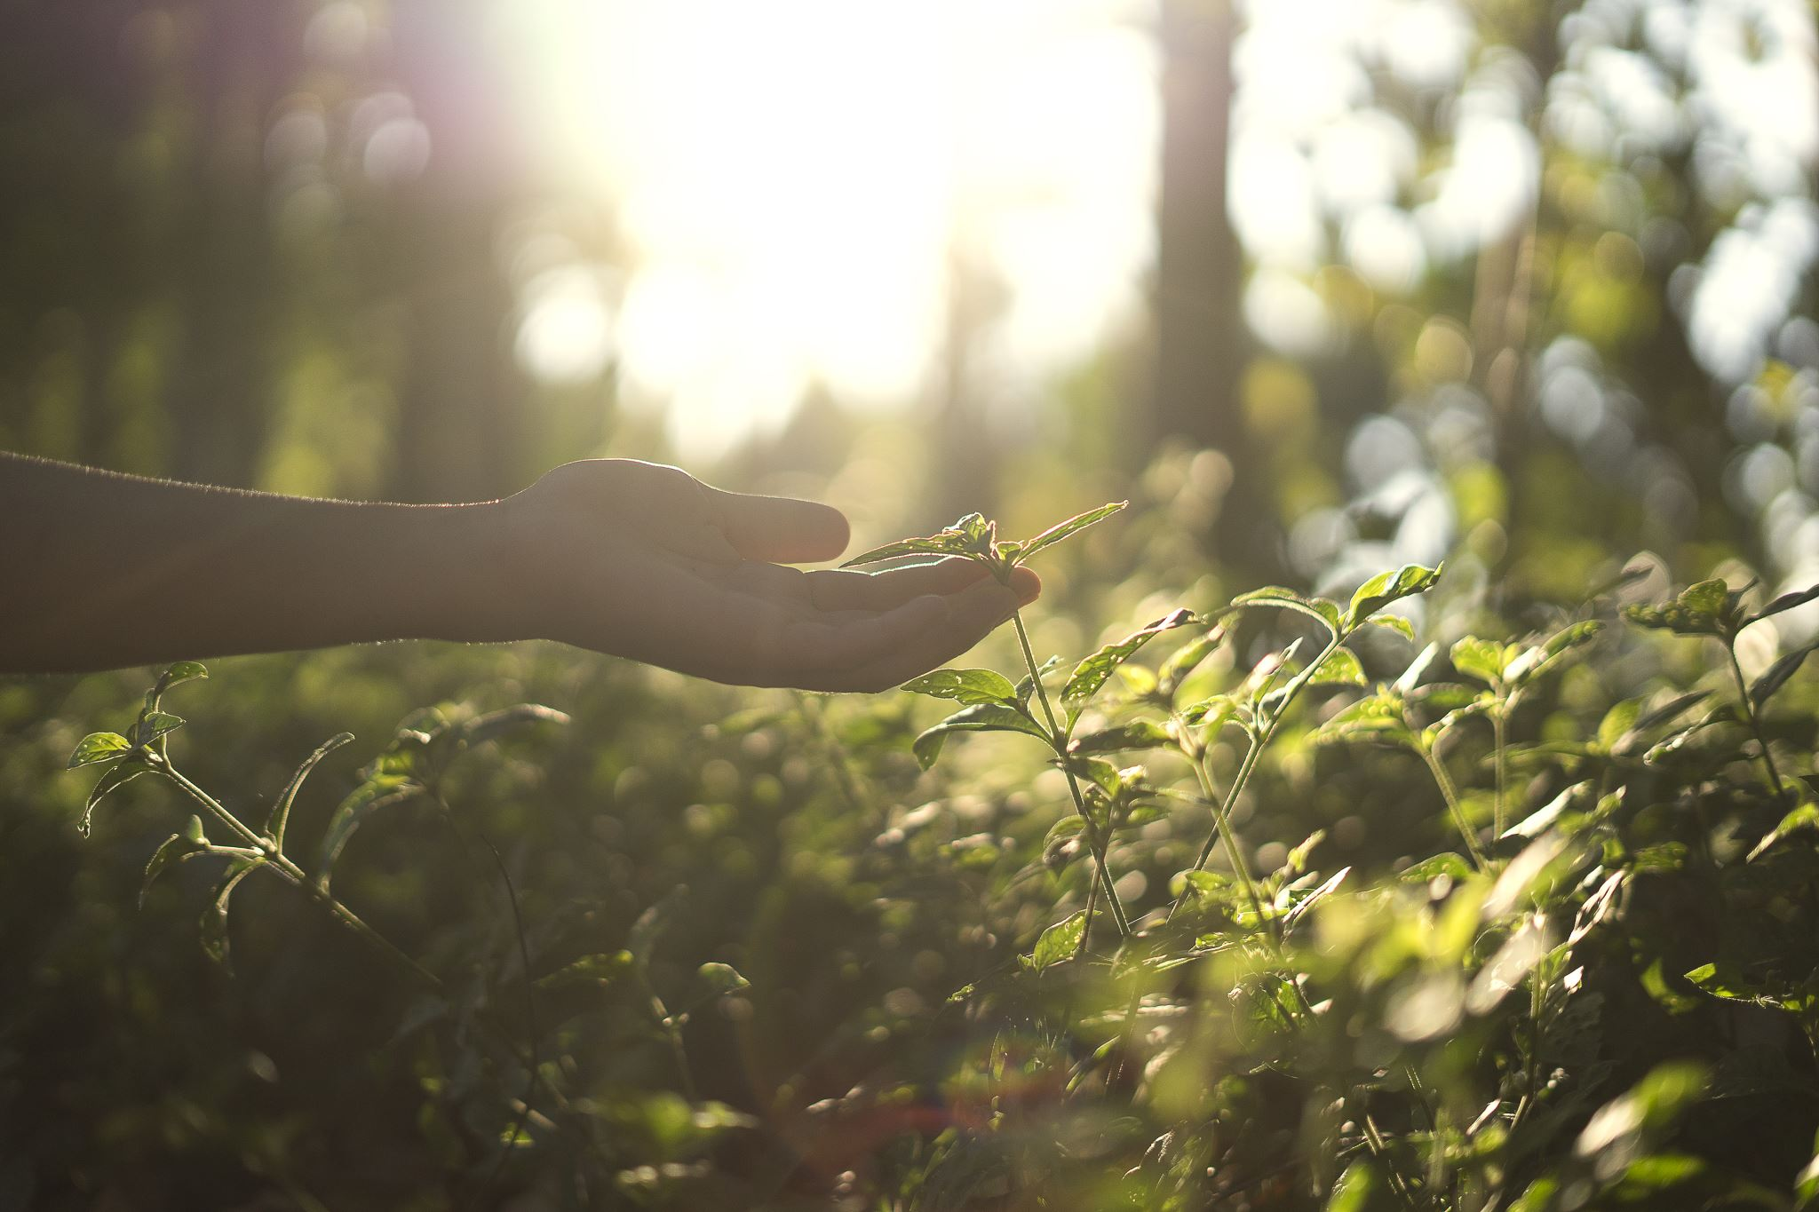
Socio-Emotional & Ethical Development will be started in BSV.

Slide 32
Thank You

